Slide 1


Modern Operating Systems
Fifth Edition
Chapter 8
Multiple Processor Systems
Copyright © 2023, 2014, 2008 Pearson Education, Inc. All Rights Reserved
Notes:
If this PowerPoint presentation contains mathematical equations, you may need to check that your computer has the following installed:
1) Math Type Plugin
2) Math Player (free versions available)
3) NVDA Reader (free versions available)

Slide 2
Multiprocessors (1)
Cranking up the clock speed is not really possible anymore
Different options to gain speed. For instance:
Multiprocessor / multicore machines
Massively parallel systems (e.g., H P C)
sometimes with
millions of C P Us
Distributed systems

Slide 3
Multiprocessors (2)
Cranking up the clock speed is not really possible anymore
Different options to gain speed. For instance:
Multiprocessor / multicore machines
Massively parallel systems (e.g., H P C)
sometimes with millions of
C P Us
Distributed systems
Cores need to communicate
Shared memory
Message passing over high-speed interconnect (
tightly coupled
systems)
Message passing over Wide-Area Networks (
loosely coupled
systems)

Slide 4
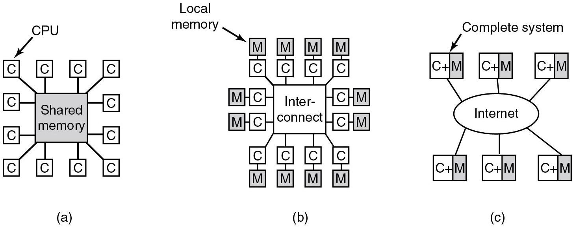
Multiple Processor Systems
Figure 8.1 (a) Shared-memory multiprocessor. (b) Message-passing multicomputer. (c) Wide area distributed system
Notes:
Long Description:
Part (a): A Shared memory placed at the center is connected to 12 C P U blocks. The C P U blocks are depicted by a square labeled C. Part (b): In this part, the 12 C P U- local memory pairs are connected to a high-speed interconnect placed at the center. Part (c): This part connects 6 complete computer systems over a wide area network, such as the Internet, to form a distributed system. Each of these has its memory. The internet is shown inside an oval at the center and the computer systems are represented by two boxes labeled C plus M.

Slide 5
Multiprocessor Hardware
Shared memory multiprocessor: all C P U s share full access to R A M
Uniform Memory Access (U M A) : all locations equally fast to access
Non Uniform Memory Access (N U M A) : some locations are faster

Slide 6
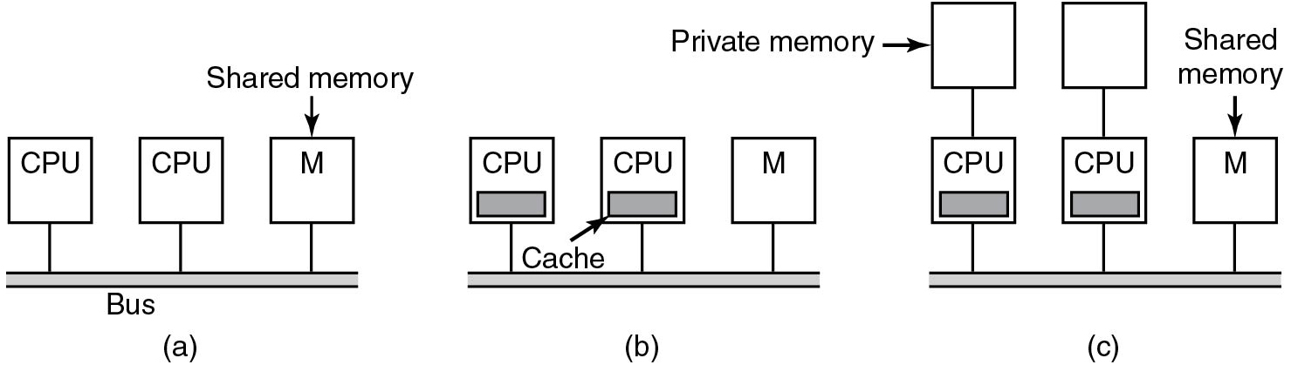
Multiprocessor Hardware: Bus (1)
To read memory: check if bus idle, put address on bus, set control bits and wait for result
If bus busy: wait
may be a long time in configuration (a)
Since memory accesses typically exhibit a lot of locality
cache
(configuration (b))
Memory reads now transfer full cache lines (64B) and cache coherence protocol needed
Figure 8.2 Bus-based multiprocessors. (a) Without caching. (b) With caching. (c) With caching and private memories.
Notes:
Long Description:
Part (a): Two C P U vertical blocks and one Shared memory vertical block labeled M are connected using a bus. Part (b): Two C P U blocks and one Shared memory block labeled M are connected using a bus. A cache horizontal highlighted block is shown inside the C P U block. Part (c): Two C P U blocks and one Shared memory block labeled M are connected using a bus. A cache block is shown inside the C P U block. Two private memory vertical blocks are connected above the C P U blocks.

Slide 7
Multiprocessor Hardware: Bus (2)
Vendors sometimes provide each C P U with small amount of private memory (configuration (c))
Especially useful for read-only data and code
reduces
bus traffic
Figure 8.2 Bus-based multiprocessors. (a) Without caching. (b) With caching. (c) With caching and private memories.
Notes:
Long Description:
Part (a): Two C P U vertical blocks and one Shared memory vertical block labeled M are connected using a bus. Part (b): Two C P U blocks and one Shared memory block labeled M are connected using a bus. A cache horizontal highlighted block is shown inside the C P U block. Part (c): Two C P U blocks and one Shared memory block labeled M are connected using a bus. A cache block is shown inside the C P U block. Two private memory vertical blocks are connected above the C P U blocks.

Slide 8
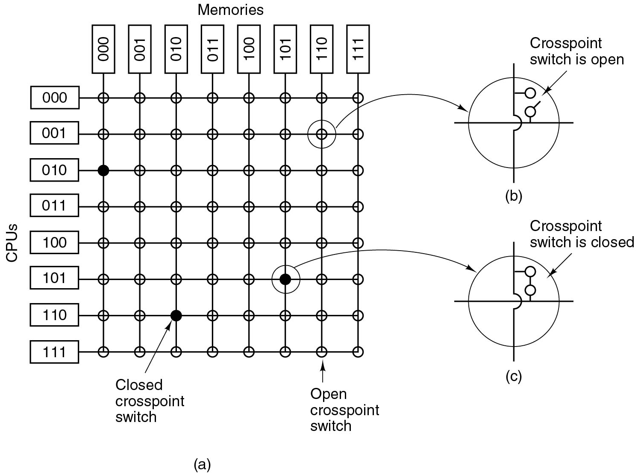
Interconnects
As no. of C P U s increases, bus becomes bottleneck
need something
else
Example: U M A Multiprocessor with Crossbar Switch
Figure 8.3
(a) An
crossbar switch.
(b) An open crosspoint.
(c) A closed crosspoint.
Non blocking network:
C P U never denied connection
No advance planning needed
Contention for memory still possible
Notes:
Long Description:
Part (a): The figure shows eight C P U blocks arranged vertically at the left. The C P U blocks from top to bottom are given as follows: 000, 001, 010, 011, 100, 101, 110, and 111. Six memory blocks are arranged horizontally from left to right at the upper end and are given as follows. 000, 001, 010, 011, 100, 101, 110 and 111. Horizontal lines are drawn from each C P U block and vertical lines are drawn from each memory block. These lines form a grid. The intersecting points are called cross-point switches, of which three are closed and others open. The magnified view of the open and closed switch are shown in part b and c. The switches are depicted by circles having a cross, and two open circles at the first quadrant of the cross. For an open switch, the two open circles are not connected, and for a closed switch the circles are connected. Part (b): An open node inside a circle is shown. The open position is labeled Crosspoint switch is open. Part (c): A closed node inside a circle is shown. The closed position is labeled Crosspoint switch is closed. Note: The open and closed switches marked in the part 1 points to the open and closed switches of parts b and c.

Slide 9
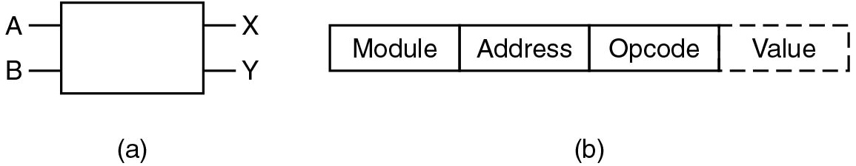
U M A Multiprocessors Using Multistage Switching Networks (1)
Simple
switch:
Messages arriving at input ports switched to output ports connected to memory modules
Module indicates the memory module (here: X or Y)
Address is memory address
Opcode: R or W
Value: e.g., value to write
Figure 8.4 (a) A
switch with two input lines, A and B, and two output lines, X and Y. (b) A message format.
Notes:
Long Description:
Part (a): A rectangular vertical block with two input lines A and B at the left, and two output lines X and Y at the right. Part (b): A horizontal block is divided equally into four, and is given as follows. Module, Address, Opcode, and Value. The last Value block is shown in dashed lines.

Slide 10
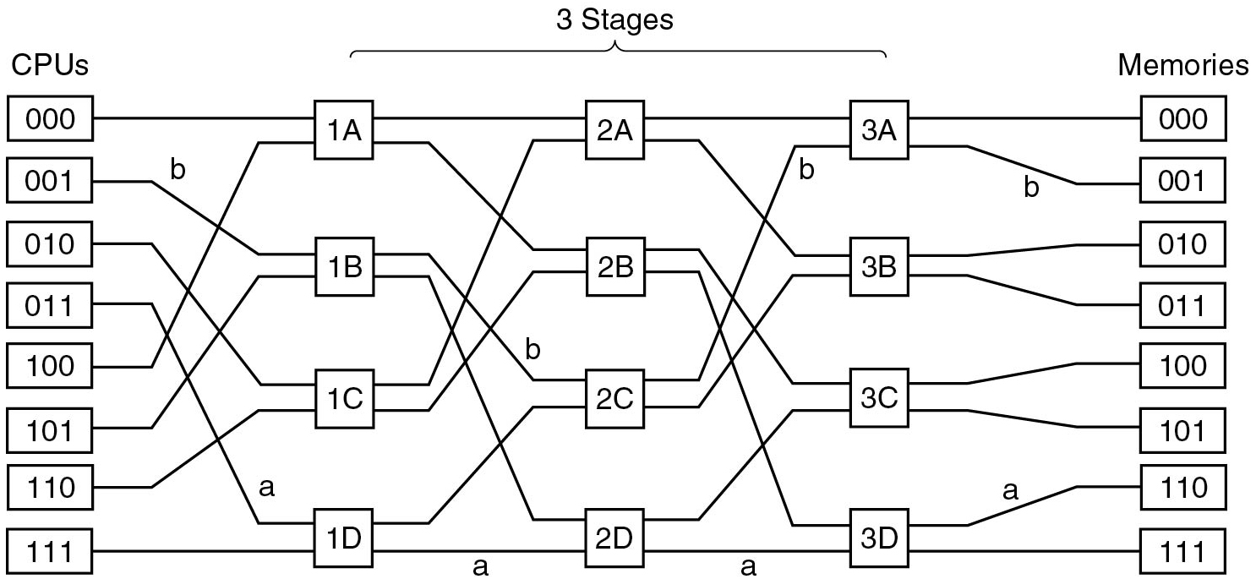
U M A Multiprocessors Using Multistage Switching Networks (2)
Combine
switches to create multistage switching network
For n C P U s and n memories:
stages of
switches per layer
Example: C P U sends msg to memory 110:
110 in module field
First switch takes left-most bit in module field, switch takes second bit, etc.
if 0
upper output
if 1
lower output
Suppose C P U s 000 and 001 both send to memory 000
Conflict in Switch 3A!
1 must wait
blocking network
Figure 8.5 An omega switching network
Notes:
Long Description:
There are eight C P U s and Memory blocks aligned vertically at the left and right. The blocks from top to bottom are given as follows. 000, 001, 010, 011, 100, 101, 110 and 111. All the C P U blocks are connected to the memory block by passing through three stages, each stage has four blocks. The blocks in stage 1 are 1 A, 1 B, 1 C, 1 D. The blocks in stage 2 are 2 A, 2 B, 2 C, 2 D. The blocks in stage 3 are 3 A, 3 B, 3 C, 3 D. Block 1: C P U block 1 is passing through 1 A, 2 A and 3 A block and connected to Memory block 1. Block 2: C P U block 2 is passing through 1 B, 2 C, and 3 A blocks and connected to Memory block 2. The passing line is denoted by b between these two blocks. Block 3: C P U block 3 is passing through 1 C, 2 A, and 3 B blocks and connected to Memory block 3. Block 4: C P U block 4 is passing through 1 D, 2 C, and 3 B blocks and connected to Memory block 4. The passing line through the block to 1 D is denoted by a Block 5: C P U block 5 is passing through 1 A, 2 B, and 3 D block and connected to Memory block 5. Block 6: C P U block 6 is passing through 1 B, 2 D, and 3 C blocks and connected to Memory block 6. Block 7: C P U block 1 is passing through 1 C, 2 B, and 3 D blocks and connected to Memory block 7. Block 8: C P U block 8 is passing through 1 D, 2 D, and 3 D blocks and is connected to Memory block 8. The passing line between 1 D to 3 D is denoted by a.

Slide 11
N U M A Multiprocessors
If no. of C P Us increases, U M A becomes difficult (or expensive)
Solution: N U M A
Characteristics of N U M A machines which distinguish them from other multiprocessors:
There is a single address space visible to all C P Us.
Access to remote memory is via LOAD and STORE instructions.
Access to remote memory is slower than access to local memory.

Slide 12
Two Types
N C-N U M A (Non Cache-coherent N U M A)
C C-N U M A (Cache-Coherent N U M A)

Slide 13
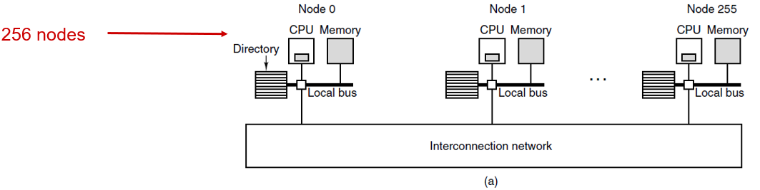
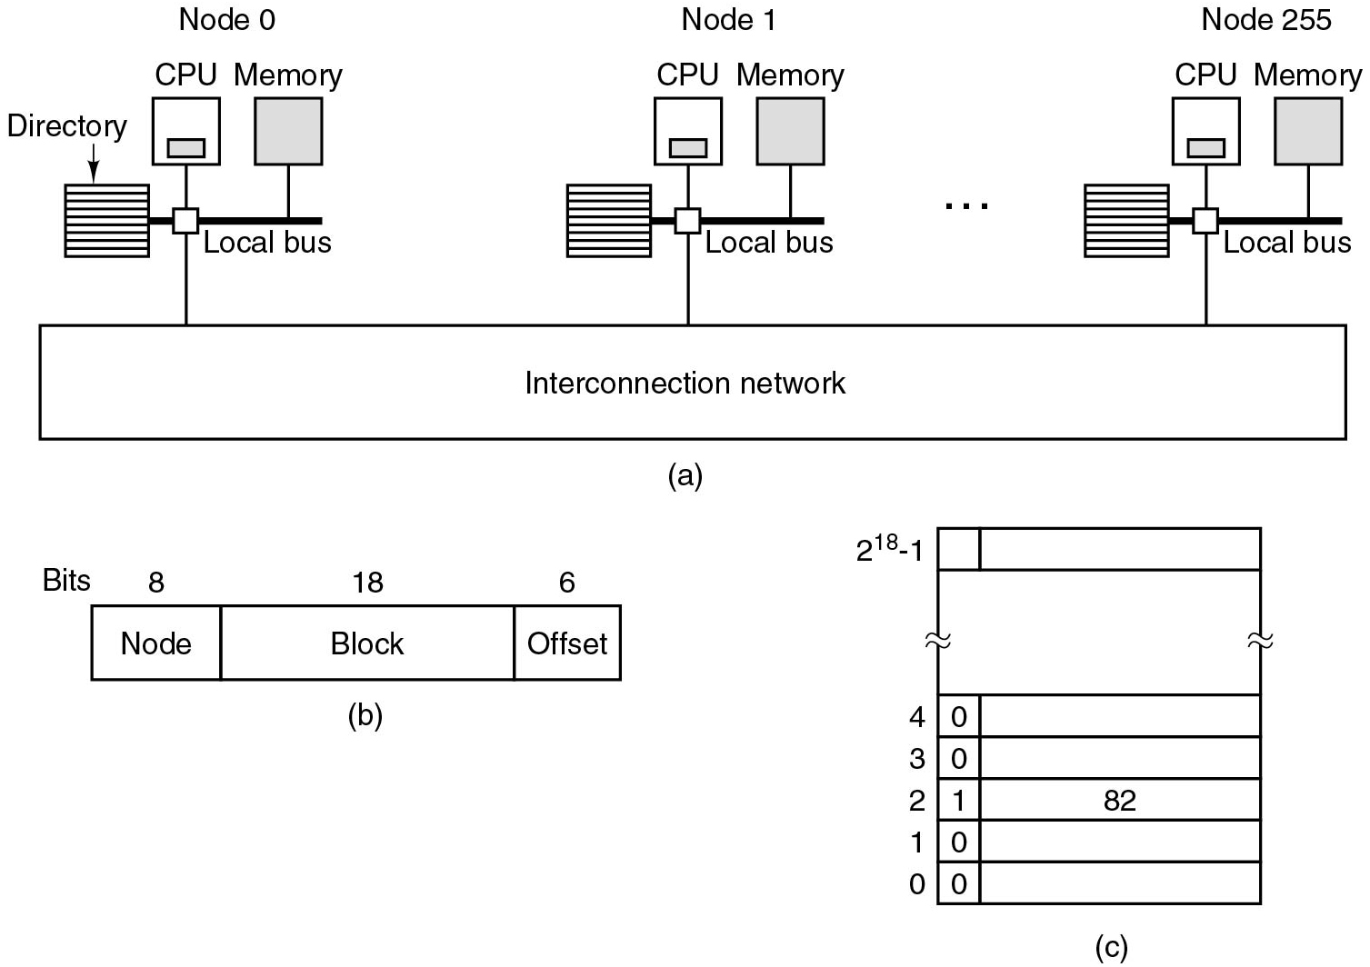
C C N U M A Multiprocessors: Directory-Based (1)
Figure 8.6
(a) 256-node directory-based multiproc.
(b) division of 32-bit address into fields.
(c) The directory at node 36.
Notes:
Long Description1:
The illustration is labeled as a in parenthesis. It shows three nodes: node 0, node 1, and node 255. A red arrow points toward the nodes and is labeled as 256 nodes. A sign of ellipsis is in between node 1 and node 255. Each node has a directory shown by a square with parallel lines, a C P U indicated by a square with a grey rectangle inside it, and a memory shown by a grey square. The directory, C P U, and memory are connected by a local bus. All nodes are connected to an interconnection network.
Long Description2:
The left illustration is labeled as b in parenthesis. It is a rectangle with 3 sections. The labeling on the top-left corner of the rectangle is bits. The three sections are labeled as 8 node, 18 block, and 6 offset from left to right. The right illustration is labeled as c in parentheses. It shows a rectangle divided into 6 sections from top to bottom. The sections are labeled from 0 to 4 on the left side from bottom to top while the top section remains unlabeled. The sections from 0 to 4 are further divided into two sections. The smaller section on the left side is labeled 0, 0, 1, 0, and 0 from top to bottom. The larger section of section 2 is labeled as 82.

Slide 14
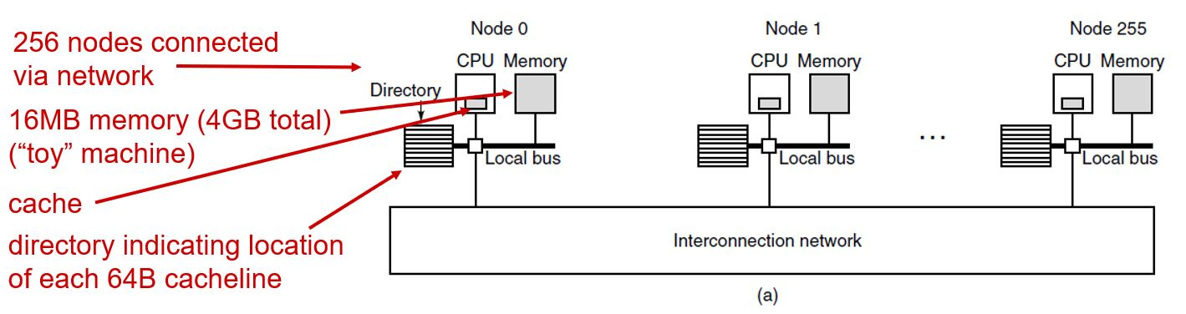
C C N U M A Multiprocessors: Directory-Based (2)
Figure 8.6 (a) 256-node directory-based multiproc.
Notes:
Long Description:
The illustration is labeled as a in parenthesis. It shows three nodes: node 0, node 1, and node 255. A sign of ellipsis is in between node 1 and node 255. Each node has a directory shown by a square with parallel lines, a C P U indicated by a square with a grey rectangle inside it, and a memory shown by a grey square. The directory, C P U, and memory are connected by a local bus. All nodes are connected to an interconnection network. A red arrow pointing toward nodes is labeled as 256 nodes connected via a network. A red arrow pointing toward memory is labeled as 16 M B memory start parenthesis 4 G B total end parenthesis start parenthesis double quotation toy double quotation machine end parenthesis. Another red arrow pointing toward C P U is labeled as cache. A red arrow pointing toward the directory is labeled as directory indicating location of each 64 B cache line.

Slide 15
C C N U M A Multiprocessors: Directory-Based (3)
C P U 20: Fetches address X
M M U:
node 36, line 4, offset 8
Sends request to C P U 36
C P U 36 receives request
looks up line in directory
sees it is not cached
fetches it from R A M and sends it to C P U 20
marks the entry as “cached at 20”

Slide 16
C C N U M A Multiprocessors: Directory-Based (4)
Now C P U 20 fetches address Y
node 36, line 2, offset 3
Send request to C P U 36
C P U 36 receives request
looks up line in directory
sees: cached at 82
C P U 36 may instruct C P U 82 to send the line to C P U 20
Figure 8.6 (a) 256-node directory-based multiproc.
(b) division of 32-bit address into fields.
(c) The directory at node 36.
Notes:
Long Description:
Part (a): There are 256 nodes connected to an interconnection network block starting from node 0 to node 255. The node block contains 3 vertical sub-blocks which are labeled C P U, Memory, and Directory. The C P U block contains a cache block inside it. All three blocks are connected to an M M U block using a local bus. The M M U block of all the 256 nodes is connected to the interconnection network. Part (b): A set of three blocks arranged horizontally labeled Node, Block, and Offset from left to right. The bits values of each block are 8, 18, and 6 respectively. Part (c): A table is shown with 7 rows and 2 columns. The address of rows is ranging from 0 to 2 raised to the 18 power minus 1. No value is assigned for row 2 and it's also a merged row by denoting approximate sign at both sides of the row. A zero value is assigned to column 1 of row 3, row 4, row 6, and row 7. Row 5, column 1 has a value of 1, and column 2 has a value of 82.

Slide 17
Multicore Processors
Multiple/many cores on same C P U
Each core has small and very fast L1 cache
Each core may also have larger and still fast L2 cache
All core share the L L C (sometimes known as L3)
Often multiple hardware contexts (or “threads”)
Example: A M D’s E P Y C Milan C P U
64 cores with 2 hardware contexts, each with
32 K B of L 1 instruction cache and 32 K B of L 1 data cache
512 K B of L 2 cache.
All cores share 256 M B of on-board L 3 cache

Slide 18
Snooping
Special hardware to ensure that
If a word is present in
caches, and
One of the C P Us modifies the word,
It is automatically and atomically removed from all other caches
This guarantees consistency
Cache coherence may not scale to many hundreds of cores.

Slide 19
Simultaneous Multithreading (S M T)
In general: each core offers multiple hardware contexts
Each hyper-thread can run a process or thread
Sometimes called virtual cores
Each hyper-thread has its own registers
Some components are shared: L 1/L 2 cache, T L B, Execution Units
Hyper-threads can interfere with each other
Performance benefits vary

Slide 20
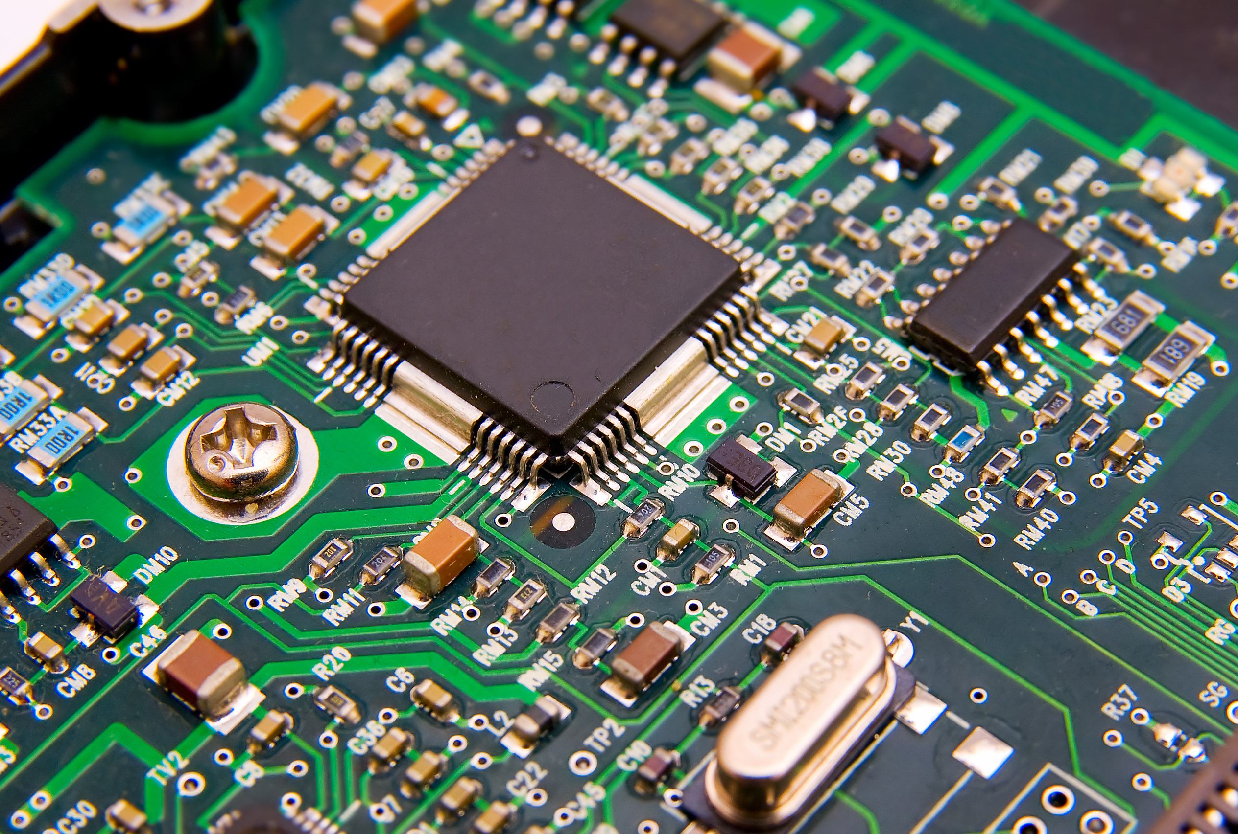
Multiprocessor Chip with Four Cores and Graphics
Skobrik/Shutterstock
Notes:
Image from: electronics.stackexchange.com (search for Creative Commons images)
Long Description:
The block diagram consists of following labelings from left to right as follows. Processor graphics, core, core, core, core, system agent and memory controller including display, D M I, and misc I slash O, shared L 3 cache, and memory controller I slash O.

Slide 21
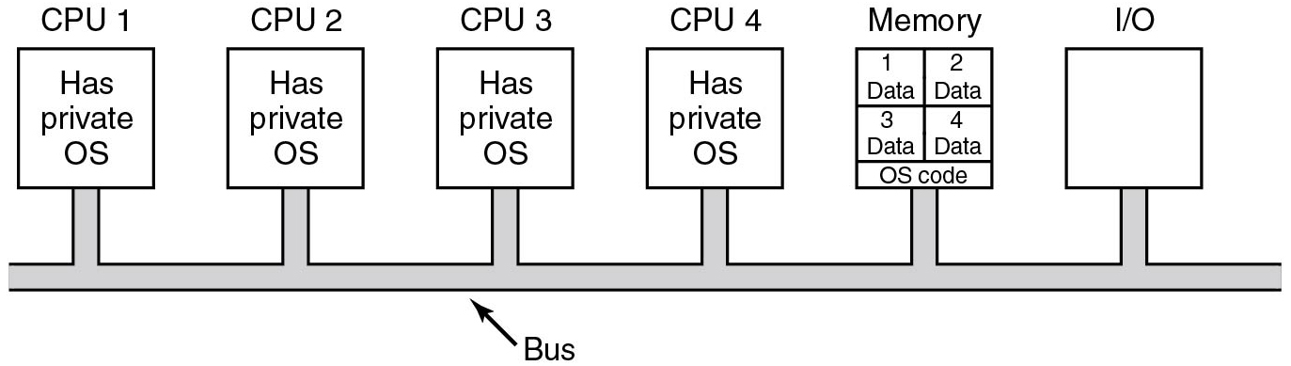
Multiprocessor Operating System Types: Each C P U Has Its Own Operating System
Like having n separate computers, but disks and I/O devices shared
However: each O S has own set of tables/processes
Also: no sharing of pages
Also: disk blocks cached per O S (not shared)
Figure 8.7 Partitioning multiprocessor memory among four C P U s, but sharing a single copy of the operating system code. The boxes marked Data are the operating system’s private data for each C P U.
Notes:
Long Description:
The illustration shows C P U 1, C P U 2, C P U 3, C P U 4, memory, and I slash O with a square from left to right. C P U 1, C P U 2, C P U 3, and C P U 4 are labeled as has private O S. Memory is divided into 5 sections: 1 data, 2 data, 3 data, 4 data, and O S code. C P U 1, C P U 2, C P U 3, C P U 4, memory, and I slash O are connected together. An arrow points toward the connection and is labeled as bus.

Slide 22
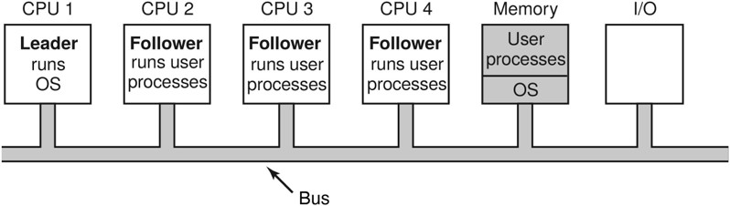
Leader-Follower Multiprocessors
With many C P Us, leader will be bottleneck
Figure 8.8 A leader-follower multiprocessor model.
Notes:
Long Description:
The illustration shows C P U 1, C P U 2, C P U 3, C P U 4, memory, and I slash O with a square from left to right. C P U 1, C P U 2, C P U 3, and C P U 4 are labeled as has private O S. Memory is divided into 5 sections: 1 data, 2 data, 3 data, 4 data, and O S code. C P U 1, C P U 2, C P U 3, C P U 4, memory, and I slash O are connected together. An arrow points toward the connection and is labeled as bus.

Slide 23
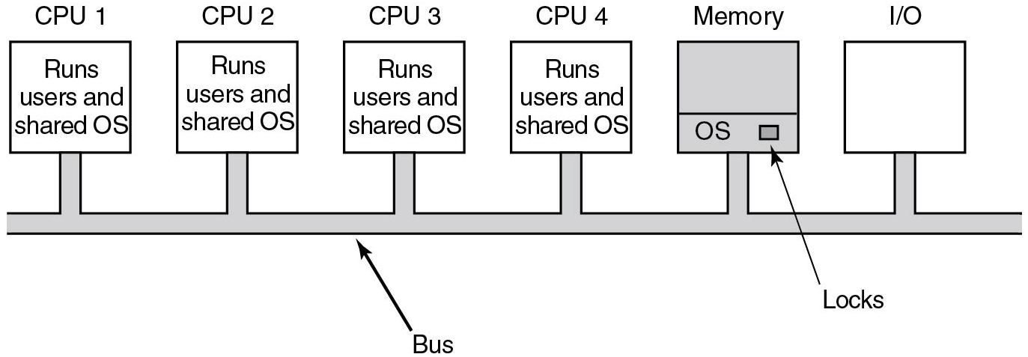
Symmetric Multiprocessors
Figure 8.9 The S M P multiprocessor model.
Solves problems of per-O S tables+caching+sharing and bottleneck of leader
However: critical regions in O S must be protected with locks
B K L versus fine-grained locking
Notes:
Long Description:
There are four vertical C P U blocks from C P U 1 to C P U 4 and are labeled Runs Users and a shared operating system. A vertical memory block is highlighted with two horizontal partitions. The first partition is empty. The second partition is labeled Operating System and a small horizontal rectangular block on the right side is labeled Locks. There is a vertical Input or Output block. All vertical blocks labeled C P U, Memory, and Input or output are connected to a common bus.

Slide 24
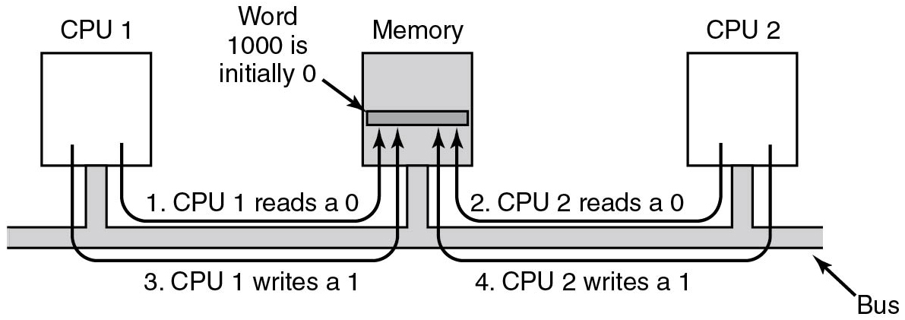
Multiprocessor Synchronization (1)
To prevent this problem, the T S L instruction must first lock the bus
Figure 8.10 The T S L instruction can fail if the bus cannot be locked. These four steps show a sequence of events where the failure is demonstrated.
Notes:
Long Description:
There are three vertical blocks from left to right labeled C P U 1, Memory, and C P U 2. All are connected via a common bus. The memory block is highlighted and has a horizontal rectangular block labeled Word 1000 is initially 0. There are four steps shown in this diagram. The first step with a forward arrow from C P U 1 points to a rectangular block in Memory labeled 1. C P U 1 reads a 0. The second step with a backward arrow from C P U 2 points to a rectangular block in Memory labeled 2. C P U 2 reads a 0. The third step with a forward arrow from C P U 1 points to a rectangular block in Memory labeled 3. C P U 1 writes a 1. The fourth step with a backward arrow from C P U 2 points to a rectangular block in Memory labeled 4. C P U 2 writes a 1.

Slide 25
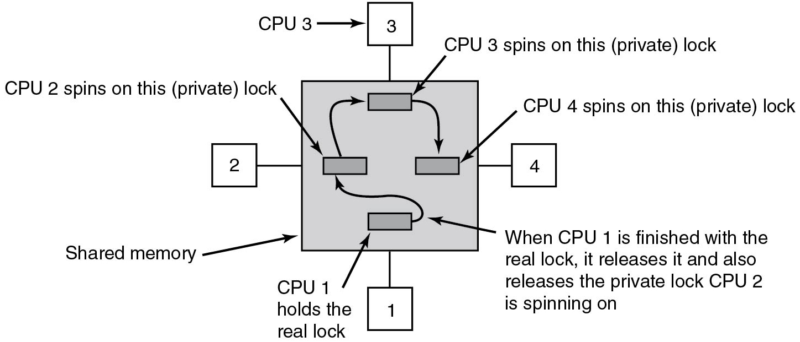
Multiprocessor Synchronization (2)
Figure 8.11 Use of multiple locks to avoid cache thrashing.
Notes:
Long Description:
A shared memory block has four C P U connected labeled from C P U 1 to C P U 4 with it in all four directions clockwise. There are four rectangular blocks placed in the shared memory in a clockwise direction and with forwarding arrows so that the first and last are not connected. The first rectangular block inside the shared memory is labeled C P U 1 and holds the real lock. A forward arrow from the first block to the second block is labeled When C P U 1 is finished with the real lock, it releases it and also releases the private lock C P U 2 is spinning on. The second rectangular block inside the shared memory is labeled C P U 2 spins on this (private) lock. The third rectangular block inside the shared memory is labeled C P U 3 spins on this (private) lock. The fourth rectangular block inside the shared memory is labeled C P U 4 spins on this (private) lock.

Slide 26
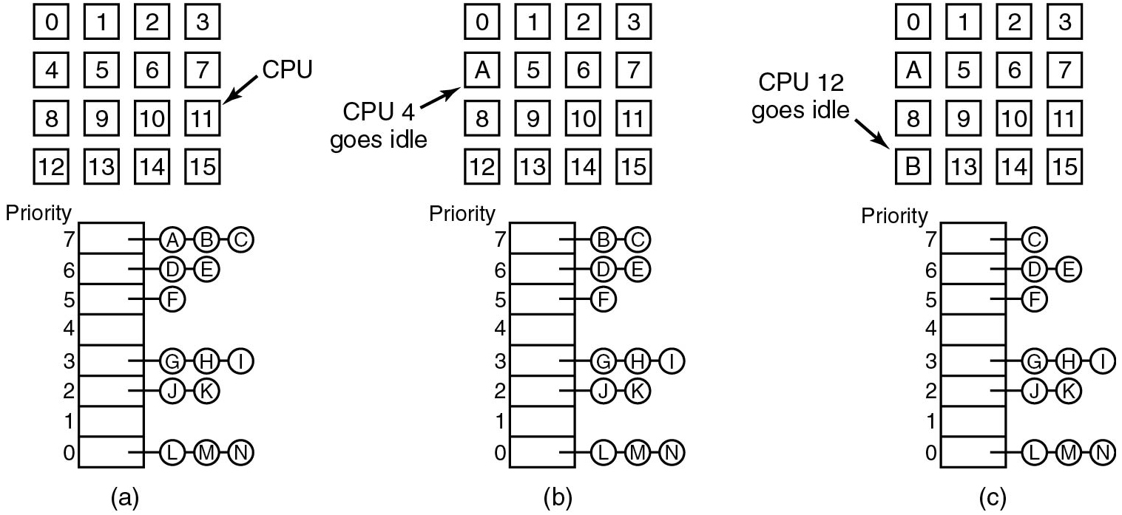
Time Sharing
Figure 8.12 Using a single data structure for scheduling a multiprocessor.
Disadvantages: potential contention for the data structure and overhead in doing a context switch when a thread blocks for I/O
Notes:
Long Description:
The image consists of three parts. Part (a): There are 16 C P U placed in the form of squares in four rows and four columns and labeled 0 to 15. There is a vertical Priority block with eight partitions starting from the bottom to the top from 0 to 7. The 0 and the last partition have three threads in the form of circles connected via straight lines and labeled L, M, and N. The first partition is empty. The second partition has two threads J and K. The third partition has three threads G, H, and I. The fourth partition is empty. The fifth partition has a single thread F. The sixth partition has two threads D and E. The seventh partition has three threads A, B, and C. Part (b): There are 16 C P U placed in the form of squares in four rows and four columns that start from 0 to 15. In row 2, column 1, instead of number 4 C P U, A is marked and labeled C P U 4 is idle. There is a vertical Priority block with eight partitions starting from the bottom to the top from 0 to 7. The 0 and the last partition have three threads in the form of circles connected via straight lines and labeled L, M, and IN. The first partition is empty. The second partition has two threads J and K. The third partition has three threads G, H, and I. The fourth partition is empty. The fifth partition has a single thread F. The sixth partition has two threads D and E. The seventh partition has two threads B, and C. Part (c): There are 16 C P U placed in the form of squares in four rows and four columns that start from 0 to 15. In row 4, column 1, instead of number 12 C P U, B is marked and labeled C P U 12 is idle. There is a vertical Priority block with eight partitions starting from the bottom to the top from 0 to 7. The 0 and the last partition have three threads in the form of circles connected via straight lines and labeled L, M, and IN. The first partition is empty. The second partition has two threads J and K. The third partition has three threads G, H, and I. The fourth partition is empty. The fifth partition has a single thread F. The sixth partition has two threads D and E. The seventh partition has one thread C.

Slide 27
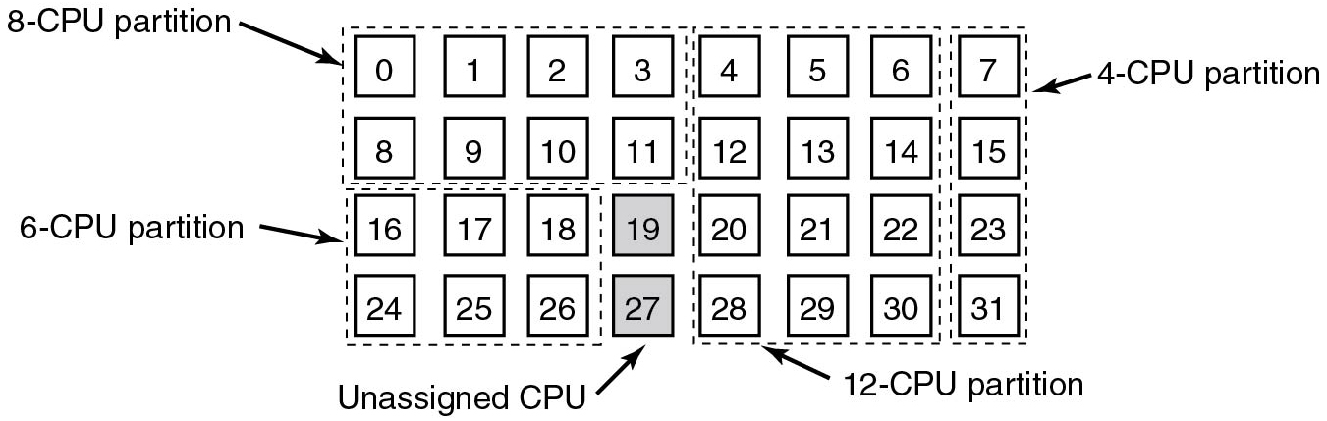
Space Sharing (1)
Figure 8.13 A set of 32 C P Us split into four partitions, with two C P Us available.
Example of Space Sharing:
If # free C P Us
threads
entire group of related threads created
at once Each thread has dedicated (i.e., nonmultiprogrammed) C P U
If not enough C P Us
none of the threads are started.
Notes:
Long Description:
There are 32 C P U that start from 0 to 21 and are arranged in four rows and eight columns. There are further partitions of sizes 4, 6, 8, and 12 C P U with the two C P U unassigned. The size 4 partition is a vertical dashed line partition that includes C P U numbers in the eighth column are 7, 15, 23, and 31. The size 6 partition is a horizontal dashed line partition that includes C P U numbers in the last two rows and the first four columns are 16, 17, 18, 19, 24, 25, 26, and 27 in which 19 and 27 numbers C P U are unassigned and highlighted. The size 8 partition is a horizontal dashed line partition that includes C P U numbers in the first two rows and the first four columns are 0, 1, 2, 3, 8, 9, 10, and 11. The size 12 partition is a vertical dashed line partition in the four rows and the three columns fifth, sixth, and seventh that includes C P U numbers are 4, 5, 6, 12, 13, 14, 20, 21, 22, 28, 29, and 30.

Slide 28
Space Sharing (2)
Advantage
Elimination of multiprogramming / context-switching overhead.
Disadvantage
Time wasted when C P U blocks with nothing to do until it becomes ready again

Slide 29
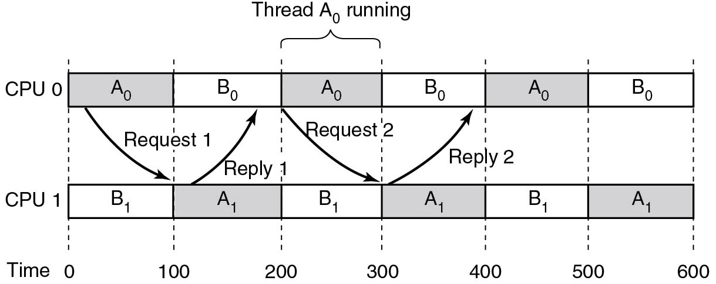
Gang Scheduling (1)
Figure 8.14 Communication between two threads belonging to thread A that are running out of phase.
and
send each other messages very quickly, concurrently with
process B’s
and
Unfortunately, they always have to wait until
time quantum expires
Solution? Gang scheduling!
Notes:
Long Description:
There are two horizontal rows and six columns with six rectangular blocks each and both rows are connected via dashed lines. The first row is labeled C P U 0 and the second row is labeled C P U 1. The dashed lines depict the Time slots between the columns that start from 0 to 600 in an increment of 100 units. Row 1 (C P U 0) has elements A subscript 0, B subscript 0, A subscript 0, B subscript 0, A subscript 0, B subscript 0. Row 2 (C P U 1) has elements B subscript 1, A subscript 1, B subscript 1, A subscript 1, B subscript 1, A subscript 1. Every alternate column in two rows is highlighted. There is a forward arrow labeled Request 1 from row 1, column 1 A subscript 0 to row 2, column 1 B subscript 1. There is an upward arrow labeled Reply 1 from row 1, column 2 A subscript 1 to row 2, column 2 B subscript 0. Again, there is a forward arrow labeled Request 2 from row 3, column 3 A subscript 0 to row 3, column 3 B subscript 1. There is an upward arrow labeled Reply 2 from row 4, column 4 A subscript 1 to row 4, column 4 B subscript 0. Row 1, column 3, is labeled Thread A subscript 0 is running.

Slide 30
Gang Scheduling (2)
Gang scheduling has three parts:
Groups of related threads are scheduled as a unit, a gang.
All members of a gang run at once on different timeshared C P Us.
All gang members start and end their time slices together.
All C P Us scheduled synchronously
time divided into
discrete quanta Start of new quantum
all C P Us are
rescheduled, with new thread being started on each one.

Slide 31
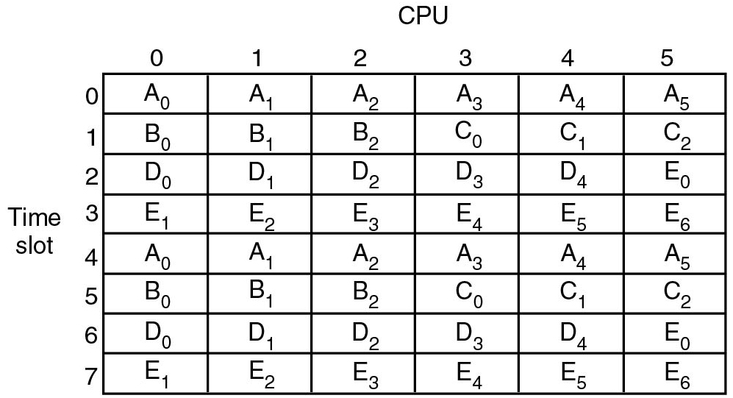
Gang Scheduling (3)
Figure 8.15 Gang scheduling.
If possible, all threads of process run together, at the same
time, on different C P Us
if one of them sends a request to
another, it will get the message immediately
Notes:
Long Description:
There is a table with 8 rows and 6 columns. The row's numbers start from 0 to 5 and the column's numbers start from 0 to 7 respectively. The rows are labeled C P U and the columns are labeled Time slot. Row 0: Column 0: A subscript 0. Column 1: A subscript 1. Column 2: A subscript 2. Column 3: A subscript 3. Column 4: A subscript 4. Column 5: A subscript 5. Row 1: Column 0: B subscript 0. Column 1: B subscript 1. Column 2: B subscript 2. Column 3: C subscript 0. Column 4: C subscript 1. Column 5: C subscript 2. Row 2: Column 0: D subscript 0. Column 1: D subscript 1. Column 2: D subscript 2. Column 3: D subscript 3. Column 4: D subscript 4. Column 5: E subscript 0. Row 3: Column 0: E subscript 1. Column 1: E subscript 2. Column 2: E subscript 3. Column 3: E subscript 4. Column 4: E subscript 5. Column 5: E subscript 6. Row 4 Column 0: A subscript 0. Column 1: A subscript 1. Column 2: A subscript 2. Column 3: A subscript 3. Column 4: A subscript 4. Column 5: A subscript 5. Row 5: Column 0: B subscript 0. Column 1: B subscript 1. Column 2: B subscript 2. Column 3: C subscript 0. Column 4: C subscript 1. Column 5: C subscript 2. Row 6: Column 0: D subscript 0. Column 1: D subscript 1. Column 2: D subscript 2. Column 3: D subscript 3. Column 4: D subscript 4. Column 5: E subscript 0. Row 7: Column 0: E subscript 1. Column 1: E subscript 2. Column 2: E subscript 3. Column 3: E subscript 4. Column 4: E subscript 5. Column 5: E subscript 6.

Slide 32
Scheduling for Security
Security issues complicate scheduling
Hyper-threads share core’s resources and interfere with each other
Facilitates side channel attacks (see Chapter 9)
Scheduler can help prevent attackers from using specific side channels
Example of consequences: Open B S D decided to disable Simultaneous Multithreading (S M T) altogether because of security

Slide 33
Multicomputers

Slide 34
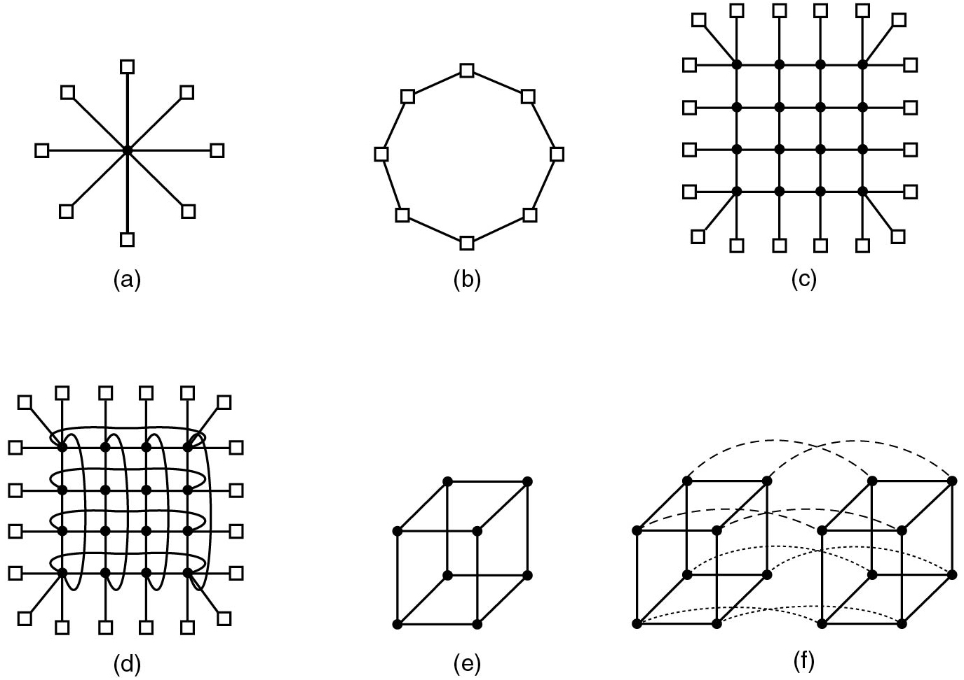
Interconnection Technology (1)
Figure 8.16 Various interconnect topologies. (a) A single switch. (b) A ring. (c) A grid. (d) A double torus. (e) A cube. (f) A 4D hypercube.
Notes:
Long Description:
Part (a): A zero-dimensional star configuration shows the main node connected with seven outer nodes. Part (b): A zero-dimensional design that is at the other end of the spectrum, a full interconnect is shown. Here every node has a direct connection to every other node. Part (c): A Tree design is shown here. The top node is split into two other nodes of level two. The nodes on level two again split into two, and form the level three. The nodes in level three again split into two and form level four. Part (d): A one-dimensional topology design ring is shown, an elliptical shape with eight equidistant points. Part (e): The grid is a two-dimensional design, in which nodes are arranged in four columns and four rows. Here every node is connected. Part (f): The cylindrical image of a grid is shown. In this, every node is connected in a circular form, forming a loop structure. Part (g): The cube is a three-dimensional topology design, where each of its edges is shown using nodes. Image H: A four-dimensional cube constructed from two three-dimensional cubes with the corresponding nodes connected. We could make a five-dimensional cube by cloning the structure and connecting the corresponding nodes to form a block of four cubes. To go to six dimensions, we could replicate the block of four cubes, interconnect the corresponding nodes, etc.

Slide 35
Interconnection Technology (2)
Two kinds of switching possible:
Circuit switching (requires setup, but good latency afterward)
Packet switching: route discrete packets (but potentially more latency)

Slide 36
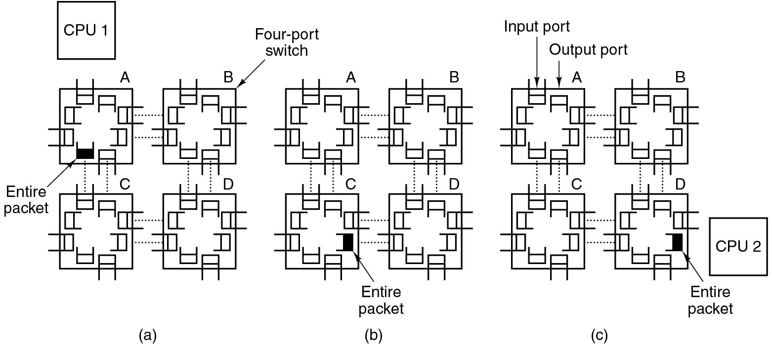
Interconnection Technology (3)
Figure 8.17 Store-and-forward packet switching.
Notes:
Long Description:
Part (a): There is a C P U 1 block on the top left. There are four-port switches labeled A, B, C, and D placed in two rows and two columns. All switches are connected via two dotted lines like A is connected to B, B to C, C to D, and D to A. In switch A, the entire packet is injected into the first switch by the source node’s network interface board and it is shown by highlighted one port. Part (b): There are four-port switches labeled A, B, C, and D placed in two rows and two columns respectively. All switches are connected via two dotted lines like A is connected to B, B to C, C to D, and D to A. The bits come in one at a time, and when the whole packet has arrived at an input buffer, it is copied to the line leading to the next switch along the path, as shown in switch C by highlighting the port. Part (c): There is a C P U 2 block on the bottom right. When the packet arrives at the switch attached to the destination node, as shown by highlighting one port in switch D, then the packet is copied to that node’s network interface board and eventually to its RAM.

Slide 37
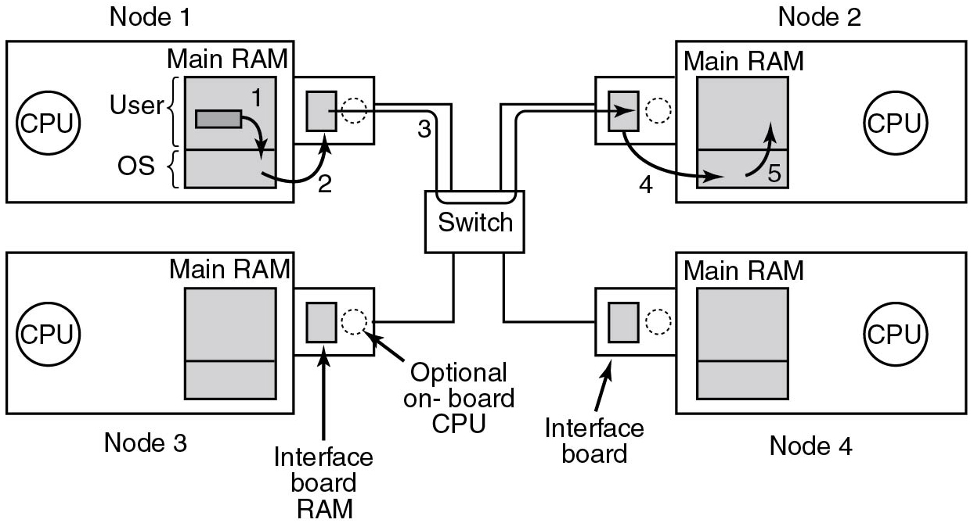
Network Interfaces
Smart N I C: Has C P U and/or F P G A in addition to D M A channels.
Figure 8.18 Position of the network interface boards in a multicomputer.
Notes:
Long Description:
There are four nodes labeled node 1, node 2, node 3, and node 4 that are placed from top to bottom and left to right. A switch is placed in the center and connected with all nodes via lines. Node 1 is a squared block that contains C P U, on the left, and on the right, Main R A M is a vertical squared block placed with two partitions labeled User on the top and the O S on the bottom. The User partition has a small horizontal rectangular block with a downward arrow labeled 1 that points to the O S partition. There is an upward arrow labeled 2 from O S that points to the outer block that is connected to node 1. The outer block has a small vertical rectangular block labeled Interface board R A M on the left and a dotted circle labeled Optional onboard C P U on the right. Like node 1 structure, the other three nodes have the same structure. There is a forward arrow from the rectangular block placed in the outer block passing through the switch and pointing to the second rectangular block of the outer block of node 2. From the rectangular block point, a downward arrow labeled 4 points to the O S of node 2. From O S, an upward arrow labeled 5 points to the User block.

Slide 38
Low-Level Communication Software
For performance:
Copy data as little as possible
Map N I C in user space
Send to destination as immediately as possible
Example: R D M A
Many N I Cs are multiqueue
buffer to support multiple users (can map in the buffers
directly)
Many also support core affinity
Send packets of the same stream to the same core

Slide 39
User-level Communication Software
At barest minimum, can be reduced to two (library) calls:
send(dest, &mptr);
receive(addr, &mptr)
The question is: how are they implemented?

Slide 40
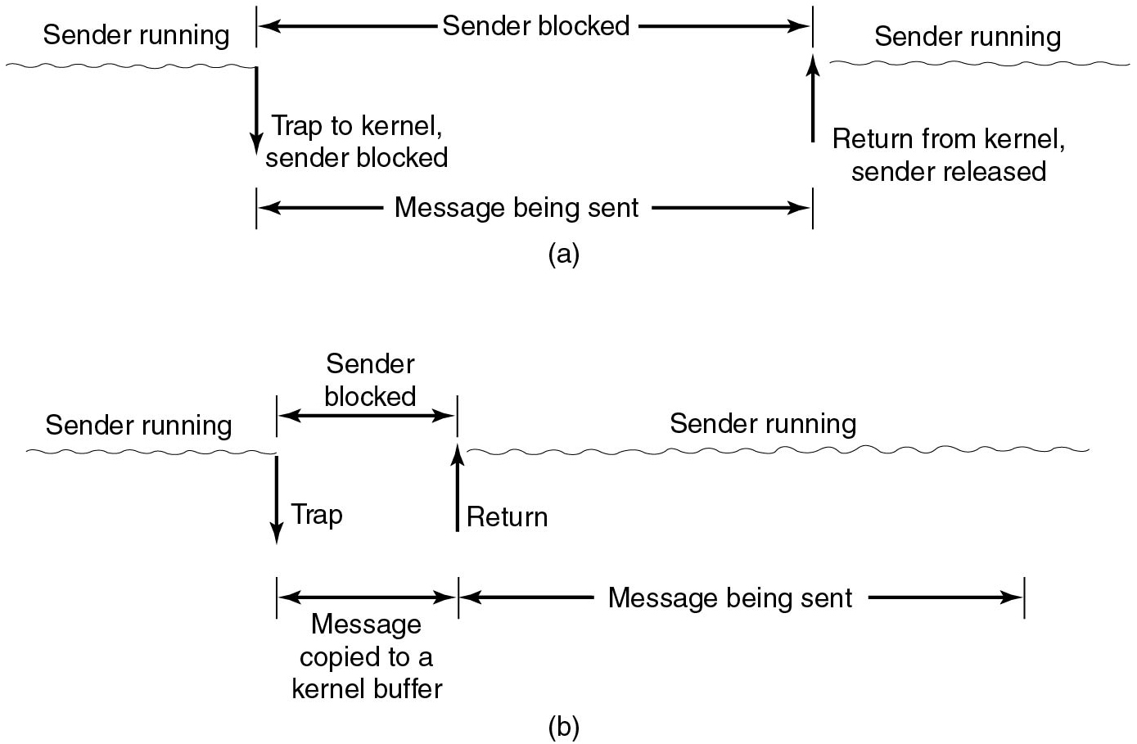
Blocking versus Nonblocking Calls (1)
Other terms used:
Synchronous versus asynchronous
Figure 8.19 (a) A blocking send call. (b) A nonblocking send call.
Notes:
Long Description:
Part (a): On the left, the sender running a process is shown as a wavy line, there is a downward arrow labeled Trap to the kernel, sender blocked from a running process. On the right, an upward arrow labeled return from the kernel, sender released. This upward arrow points to another process sent by the sender and is shown as a wavy line. In between, from left to right between processes, on the top, a bidirectional arrow labeled Sender blocked. Similarly, at the bottom, a bidirectional arrow labeled the message being sent. Part (b): On the left, the sender running a process is shown as a wavy line, there is a downward arrow labeled Trap, sender blocked from a running process. On the right, an upward arrow labeled return, sender released is shown as a wavy line. This upward arrow points to another process sent by the sender. In between, from left to right between processes, on the top, a bidirectional arrow labeled Sender blocked. Similarly, at the bottom, a bidirectional arrow labeled the message copied to a kernel buffer. Also, when the second process is running, at the bottom, a bidirectional arrow labeled the message being sent.

Slide 41
Blocking versus Nonblocking Calls (2)
Choices on the sending side:
Blocking send (C P U idle during transmission).
Nonblocking send with copy (C P U time wasted for the extra copy).
Nonblocking send with interrupt (makes programming difficult).
Copy on write (extra copy probably needed eventually).

Slide 42
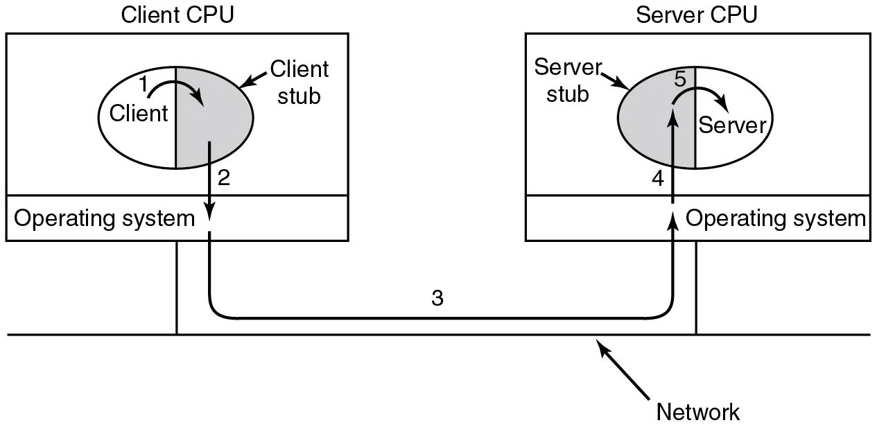
Remote Procedure (R P C) (1)
Send and receive perhaps not the best programming model
Alternative: R P C
Figure 8.20 Steps in making a remote procedure call. The stubs are shaded gray.
Notes:
Long Description:
On the left, a vertical rectangular block labeled Client C P U with two partitions of different sizes. The first partition of large size has a circle with a vertical partition. The left of the circle is labeled Client and the right of the circle is shaded and labeled Client stub. There is a downward arrow labeled 1 from Client that points to Client stub. There is a downward arrow labeled 2 from the client stub that points to the second partition of Client C P U and is labeled Operating system. On the right, is a vertical rectangular block labeled Server C P U with two partitions of different sizes. The first partition of large size has a server with a vertical partition. The left of the circle is shaded and labeled Server stub and the right of the circle is labeled Server. There is an upward arrow labeled 3 from the Client's operating system that points to the server's operating system. There is another upward arrow labeled 4 from the server's operating system that points to the server stub. There is a forward arrow labeled 5 from the server stub that points to the server. Both, the client and server C P U are connected to the common network.

Slide 43
Remote Procedure Call (2)
Figure 8.20 Steps in making a remote procedure call. The stubs are shaded gray.
Notes:
Long Description:
On the left, a vertical rectangular block labeled Client C P U with two partitions of different sizes. The first partition of large size has a circle with a vertical partition. The left of the circle is labeled Client and the right of the circle is shaded and labeled Client stub. There is a downward arrow labeled 1 from Client that points to Client stub. There is a downward arrow labeled 2 from the client stub that points to the second partition of Client C P U and is labeled Operating system. On the right, is a vertical rectangular block labeled Server C P U with two partitions of different sizes. The first partition of large size has a server with a vertical partition. The left of the circle is shaded and labeled Server stub and the right of the circle is labeled Server. There is an upward arrow labeled 3 from the Client's operating system that points to the server's operating system. There is another upward arrow labeled 4 from the server's operating system that points to the server stub. There is a forward arrow labeled 5 from the server stub that points to the server. Both, the client and server C P U are connected to the common network.

Slide 44
Distributed Shared Memory (D S M) (1)
R P C has its attractions, but many programmers prefer a shared memory model
D S M:
Each machine has its own virtual memory and page tables
When C P U does LOAD or STORE on page it does not
have
trap to O S
O S locates page, asks the C P U currently holding it to unmap page and send it over the interconnection network.
When it arrives, page is mapped in and faulting instruction restarted.
Basically: O S satisfies page faults from remote R A M instead of from local disk.

Slide 45
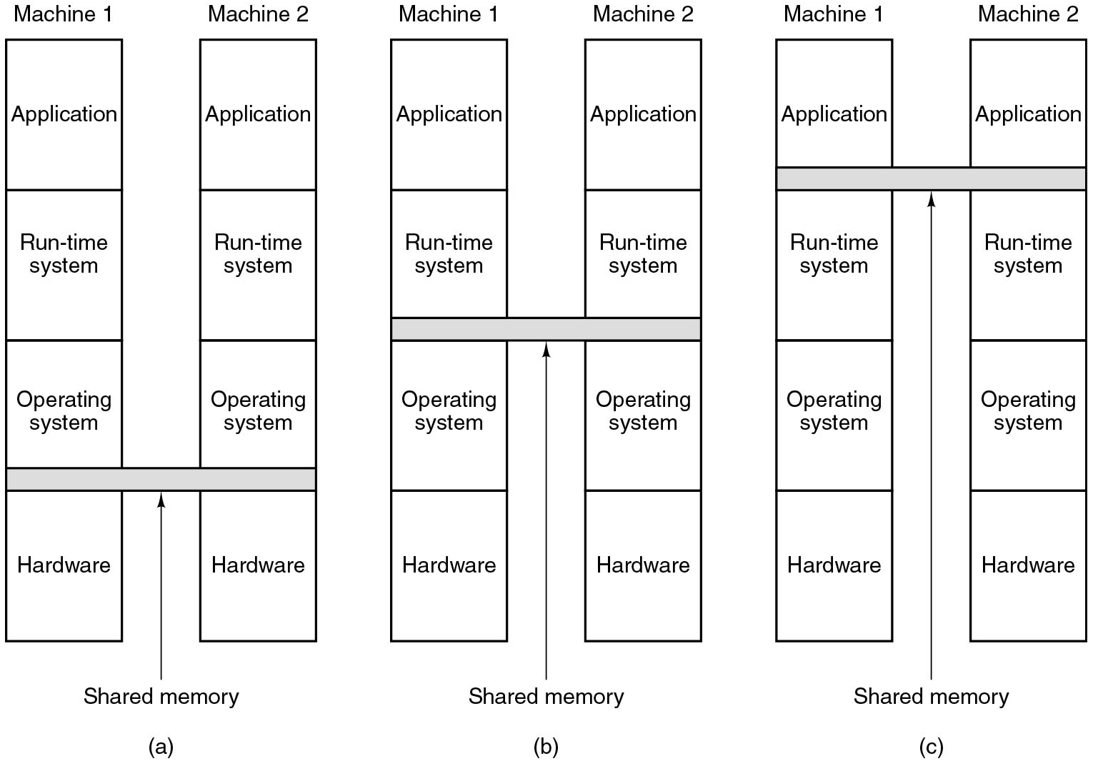
Distributed Shared Memory (2)
Figure 8.21 Various layers where shared memory can be implemented. (a) The hardware. (b) The operating system. (c) User-level software.
Notes:
Long Description:
Part (a): There is a vertical block labeled Machine 1 with four partitions Application, Run-time system, Operating system, and Hardware from top to bottom. Similarly, on the right, Machine 2 is placed. A true multiprocessor with physical shared memory implemented by the hardware and shown by highlighting the two horizontal lines between machine 1 and machine 2 at the top of the hardware partition of both machines. Part (b): The structure of machines 1 and 2 are the same as in part (a). The shared memory is implemented by the operating system. Part (c): The structure of machines 1 and 2 are the same as in part (a). The shared memory is implemented by the Run-time system.

Slide 46
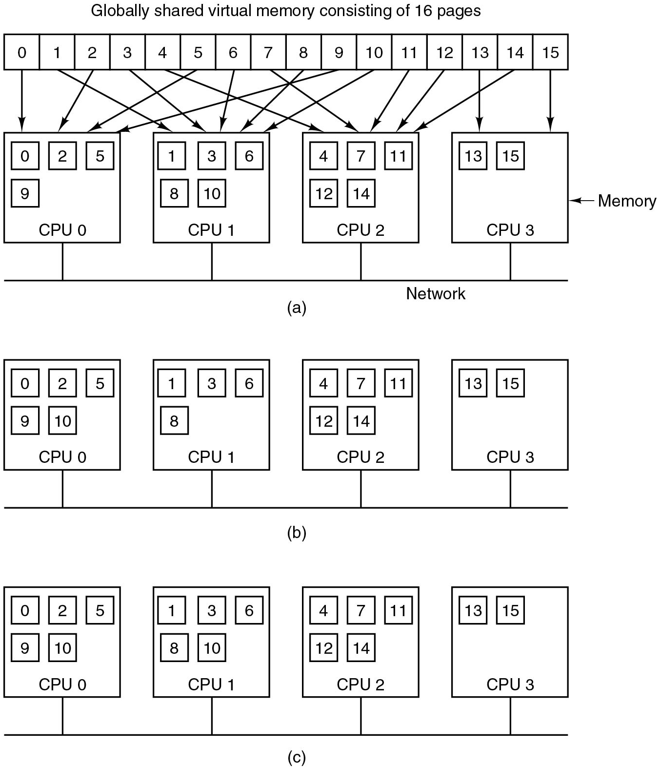
Distributed Shared Memory (3)
Figure 8.22 (a) Pages of the address space distributed among four machines.
Notes:
Long Description:
The illustration is labeled as a in parenthesis. The text at the top reads globally shared virtual memory consisting of 16 pages. A rectangle below the text is divided into 16 equal sections and labeled from 0 to 15 from left to right. It shows C P U 0, C P U 1, C P U 2, and C P U 3 with a square from left to right. C P U 0 has 4 small squares labeled 0, 2, 5, and 9. C P U 1 has 5 small squares labeled 1, 3, 6, 8, and 10. C P U 2 has 5 small squares labeled 4, 7, 11, 12, and 14. C P U 3 has 2 small squares labeled 13 and 15. All the C P U are connected parallelly with a network. An arrow points from 0 to C P U 0, 1 to C P U 1, 2 to C P U 0, 3 to C P U 1, 4 to C P U 2, 5 to C P U 0, 6 to C P U 1, 7 to C P U 2, 8 to C P U 1, 9 to C P U 0, 10 to C P U 1, 11 to C P U 2, 12 to C P U 2, 13 to C P U 3, 14 to C P U 2, and 15 to C P U 3. Another arrow points toward C P U 3 and is labeled as memory.

Slide 47
Distributed Shared Memory (4)
Figure 8.22 (b) Situation after C P U 1 references page 10 and the page is moved there.
Notes:
Long Description:
The illustration is labeled as b in parenthesis. It shows C P U 0, C P U 1, C P U 2, and C P U 3 with a square from left to right. C P U 0 has 5 small squares labeled 0, 2, 5, 9, and 10. C P U 1 has 4 small squares labeled as 1, 3, 6, and 8. C P U 2 has 5 small squares labeled 4, 7, 11, 12, and 14. C P U 3 has 2 small squares labeled 13 and 15. All the C P U are connected parallelly.

Slide 48
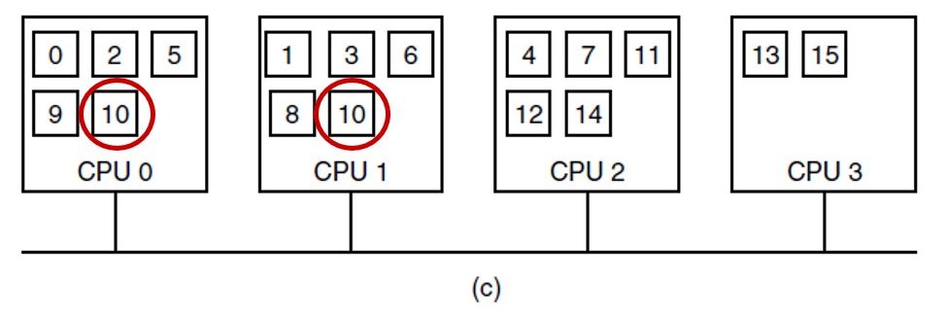
Distributed Shared Memory (5)
Improvement: replicate pages that are read only
Figure 8.22 (c) Situation if page 10 is read only and replication is used.
Notes:
Long Description:
The illustration is labeled as c in parenthesis. It shows C P U 0, C P U 1, C P U 2, and C P U 3 with a square from left to right. C P U 0 has 5 small squares labeled 0, 2, 5, 9, and 10, and the square with 10 as labeling has a red circle around it. C P U 1 has 5 small squares labeled as 1, 3, 6, 8, and 10 and the square with 10 as labeling has a red circle around it. C P U 2 has 5 small squares labeled 4, 7, 11, 12, and 14. C P U 3 has 2 small squares labeled 13 and 15. All the C P U are connected parallelly.

Slide 49
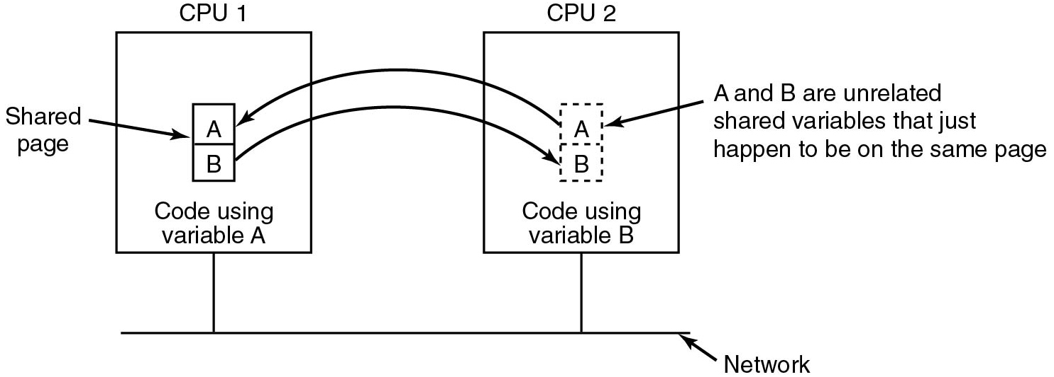
False Sharing
Figure 8.23 False sharing of a page containing two unrelated variables.
False sharing is a general problem. For instance, it may also occur in C P U caches
Notes:
Long Description:
There are C P U 1 and C P U 2 placed from left to right and are connected by a common network. Both the C P U have a small vertical block with two partitions in which A is placed at the top and B is placed at the bottom. C P U 2 has a dashed outline of a vertical block. The vertical block of C P U 1 is labeled Shared page and at the bottom of the block, an instruction is labeled Code using variable A. The vertical block of C P U 2 is labeled A and B are unrelated, shared variables that just happen to be on the same page and at the bottom of the block, an instruction is labeled Code using variable B. There is a backward arrow from C P U 2 A partition that points to C P U 1 A partition. There is a forward arrow from C P U 1 B partition that points to C P U 2 B partition.

Slide 50
Processor Allocation Algorithms and Load Balancing
Processor allocation algorithms How processes are assigned to C P Us in multiprocessor system
Algorithms differ in assumptions about what is known and what the goal is

Slide 51
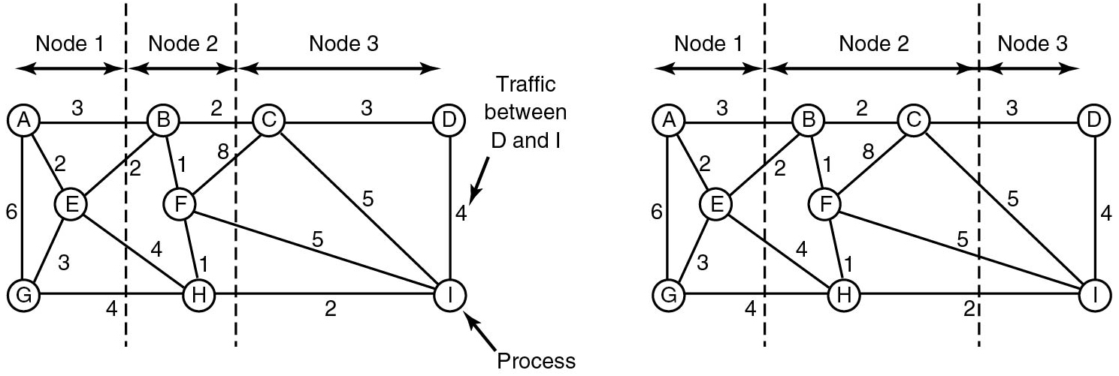
Graph-Theoretic Deterministic Algorithm
Figure 8.24. Two ways of allocating nine processes to three nodes.
Notes:
Long Description:
Part (a): There are three nodes labeled Node 1, Node 2, and Node 3. Node 1 contains three processes labeled A, E, and G. Node 2 contains B, F, and H. Node 3 contains C, D, and I. It shows a system of nine processes, A through I, with each arc labeled with the mean communication load between those two processes. A to B load is 3, B to C load is 2, C to D load is 3, A to E load is 2, B to E load is 2, B to F load is 1, C to F load is 8, A to G load is 6, E to G load is 3, G to H load is 4, E to H load is 4, F to H load is 1, H to I load is 2, F to I load is 5, C to I load is 5, D to I load is 4. The total network traffic is the sum of the arcs intersected by the cuts (the dashed lines), or 30 units. The dashed lines are in between node 1, node 2, and node 3. Part (b): Nodes are connected with loads similar way in part (a). The only difference is a different partitioning that has only 28 units of network traffic. Node 1 contains three processes labeled A, E, and G. Node 2 contains B, C, F, and H. Node 3 contains D, and I. The dashed lines are in between node 1, node 2, and node 3.

Slide 52
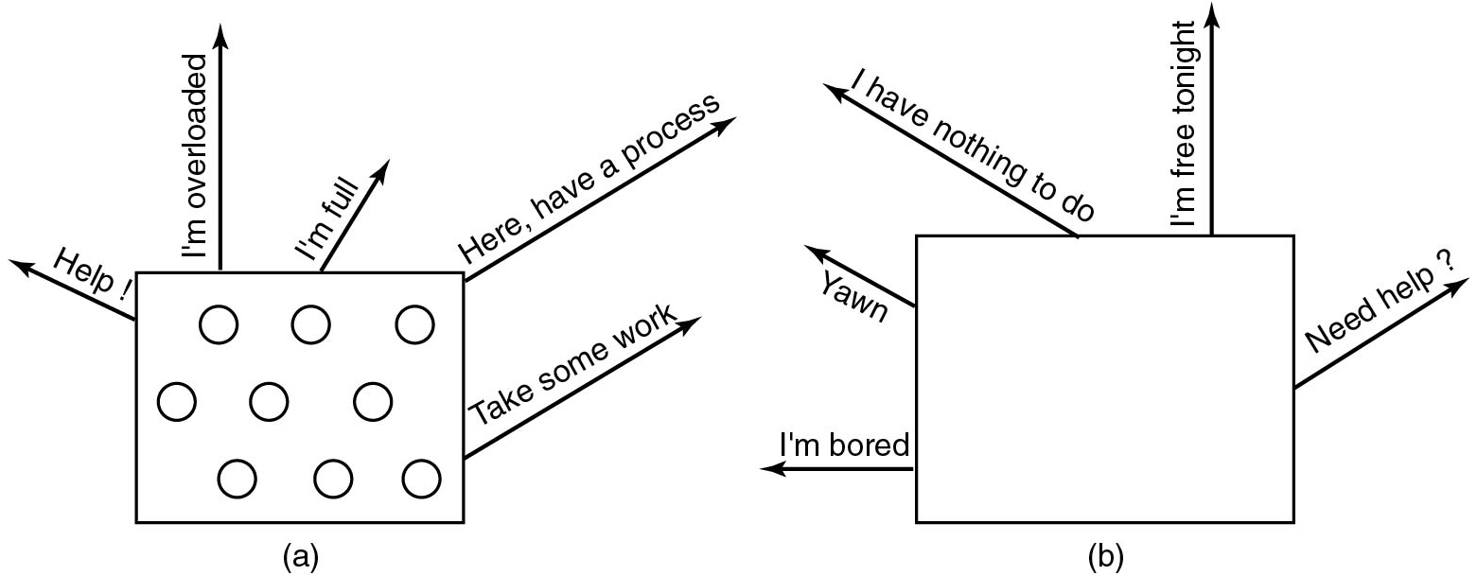
Sender-Initiated Distributed Heuristic Algorithm
Figure 8.25. (a) An overloaded node looking for a lightly loaded node to hand off processes to.(b) An empty node looking for work to do.
Notes:
Long Description:
Part (a): There is a squared block with 9 circles. There are five upward arrows from the square labeled Help with an exclamation, I'm overloaded, I'm full, Here, have a process, Take some work. Part (b): There is a squared box that has upward arrows labeled I'm bored, Yawn, I have nothing to do, I'm free tonight, Need help question mark.

Slide 53
Distributed Systems
We have seen
Multicores,
Multiprocessors, and
Multicomputers
Let us now turn to the biggest of them all: distributed systems
Similar to multicomputers but even more loosely coupled

Slide 54
Distributed Systems (1)
Item | Multiprocessor | Multicomputer | Distributed System
Node configuration | C P U | C P U, R A M, net interface | Complete computer
Node peripherals | All shared | Shared exc. Maybe disk | Full set per node
Location | Same track | Same room | Possibly worldwide
Internode communication | Shared R A M | Dedicated interconnect | Traditional network
Operating systems | One, shared | Multiple, same | Possibly all different
File systems | One, shared | One, shared | Each node has own
Administration | One organization | One organization | Many organizations
Figure 8.26 Comparison of 3 kinds of multiple C P U systems

Slide 55
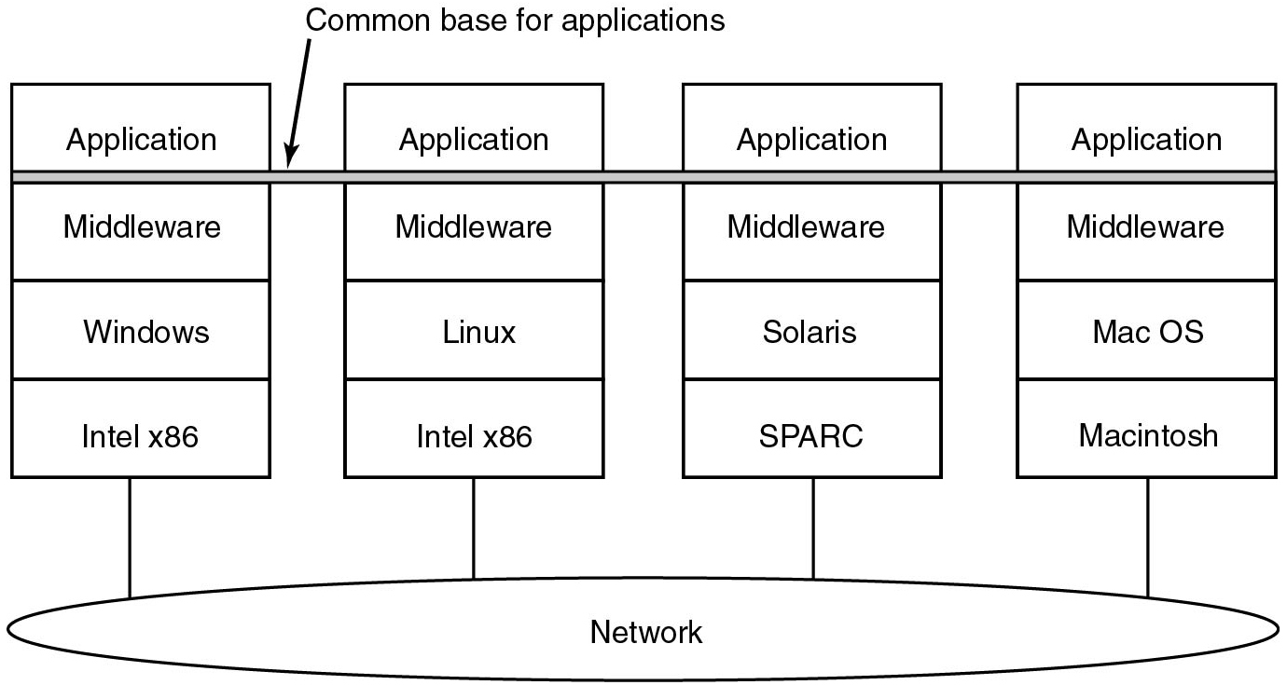
Distributed Systems (2)
Figure 8.27 Positioning of middleware in a distributed system.
Notes:
Long Description:
There are four vertical blocks connected to a common network. The first block has four partitions from top to bottom and is labeled Application, Middleware, Windows, and Intel x 86. The second block has four partitions from top to bottom and is labeled Application, Middleware, Linux, and Intel x 86. The third block has four partitions from top to bottom and is labeled Application, Middleware, Solaris, and S P A R C. The fourth block has four partitions from top to bottom and is labeled Application, Middleware, Mac O S, and Macintosh. There is a common horizontal highlighted layer between all four blocks in between Applications and Middleware and the layer is labeled Common base for applications.

Slide 56
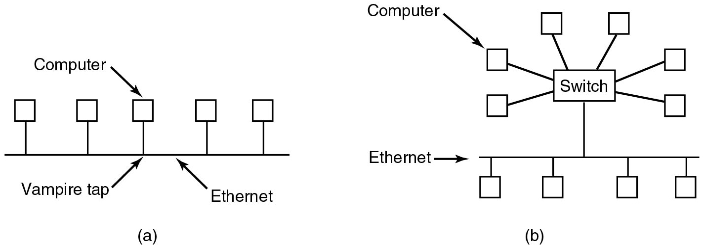
Network Hardware Ethernet
Figure 8.28 (a) Classic Ethernet. (b) Switched Ethernet.
Notes:
Long Description:
Part (a): There are five squared blocks labeled computer connected via straight line to common line labeled ethernet. The straight line from computer to ethernet is labeled Vampire Tap. Part (b): There are six computers connected to a switch in the center. The switch is connected to a common ethernet and the ethernet line has four squared blocks connected to it at the bottom.

Slide 57
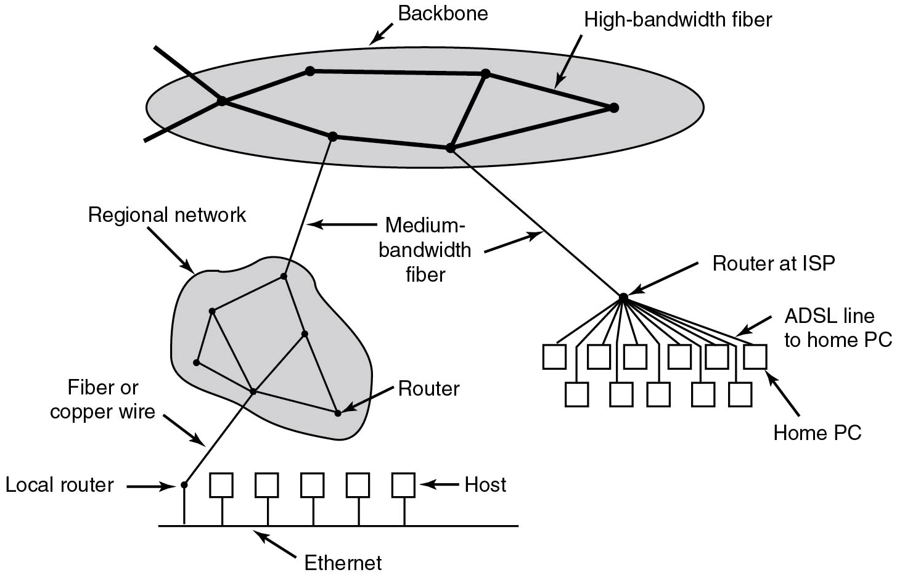
The Internet
Figure 8.29 A portion of the Internet.
Notes:
Long Description:
At the top, one of the backbones, is normally operated by a backbone operator. It consists of several routers connected by high-bandwidth fiber optics, with connections to backbones operated by other (competing) telephone companies. Usually, no hosts connect directly to the backbone, other than maintenance and test machines run by the telephone company. At the medium layer, various routers from the backbone operator are connected to the regional network via medium bandwidth fiber, and some routers are connected with the routers at I S P. From routers at I S P, various A D S L lines to home P C are connected. At the lower layer, various routers from the regional network are connected to Local routers via fiber or copper wires. The local routers are connected to the Ethernet and all hosts at lower levels are connected to Ethernet.

Slide 58
Network Services (1)
Six different types of network service.
Connection Oriented
Service | Example
Reliable message stream | Sequence of pages of a book
Reliable byte stream | Remote login
Unreliable Connection | Digitized voice

Slide 59
Network Services (2)
Six different types of network service.
Connectionless
Service | Example
Unreliable datagram | Network test packets
Acknowledged datagram | Registered mails
Request-reply | Database query

Slide 60
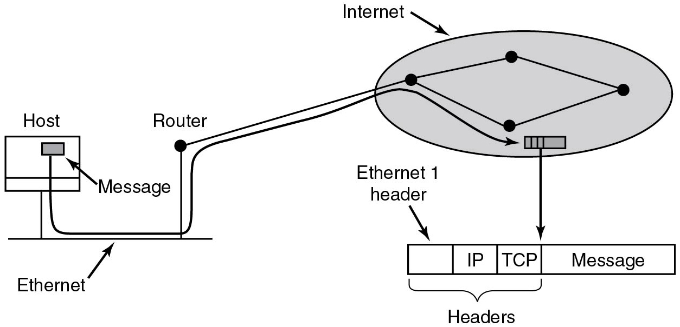
Network Protocols
Figure 8.31 Accumulation of packet headers.
Notes:
Long Description:
The host is on an Ethernet connection to the Internet. The user process generates the message and makes a system call to send it on a previously established T C P connection. The kernel protocol stack adds a T C P header and then an I P header to the front of the message. Then it goes to the Ethernet driver, which adds an Ethernet header directing the packet to the router on the Ethernet. This router then injects the packet into the Internet as shown.

Slide 61
Middleware
“Software that provides common services and capabilities to applications outside of what's offered by the operating system. Data management, application services, messaging, authentication, and A P I management are all commonly handled by middleware. Middleware helps developers build applications more efficiently.” -- Wikipedia
— Red Hat definition
In the next few slides, we will look at different kinds
This is a topic in and of itself, and we will only discuss the basics

Slide 62
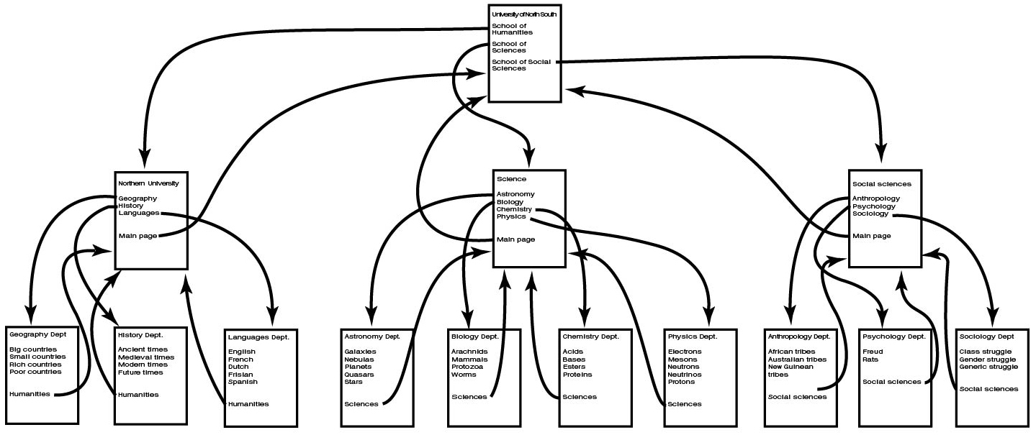
Document-Based Middleware (1)
Figure 8.32 The Web is a big directed graph of documents.
Notes:
Long Description:
There is a main document at the top. At the second level, there are three documents connected to the first level document. At the third level, there are several documents connected to each document at the second level.

Slide 63
Document-Based Middleware (2)
For the browser to get the page
http://www.minix3.org/getting-started/index.html
Browser asks D N S for I P address of
www.minix3.org
D N S replies with 66.147.238.215
Browser makes a T C P connection to port 80 on 66.147.238.215
Browser sends a request asking for the file
getting-started/index.html

Slide 64
Document-Based Middleware (3)
The
www.minix3.org
server sends the file
getting-started/index.html
Browser displays all the text in
getting-started/index.html.
Browser also fetches and displays all images on the page
The T C P connection is released

Slide 65
File-System-Based Middleware: Transfer Model (1)
Web: make a distributed system look like giant collection of hyperlinked docs.
Alternative: make a distributed system look like great big file system.

Slide 66
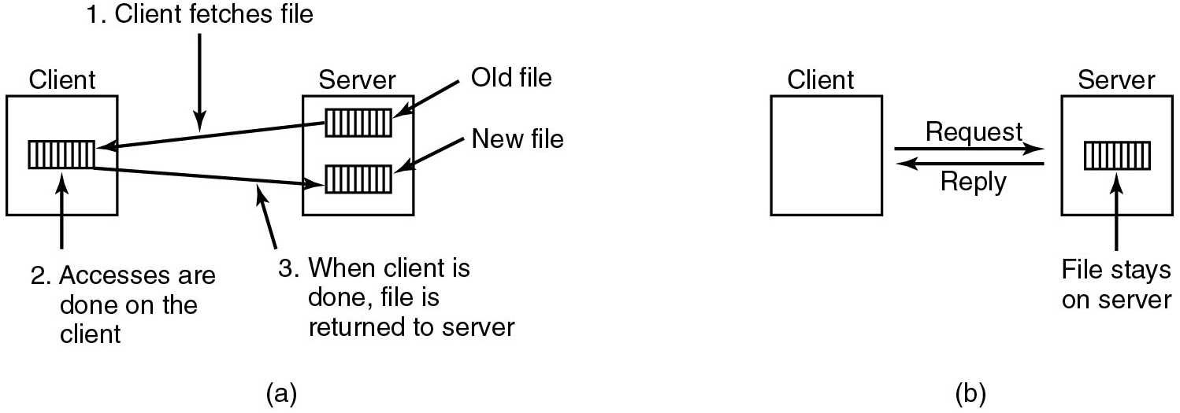
File-System-Based Middleware: Transfer Model (2)
Figure 8.33 (a) The upload/download model. (b) The remote access model.
Upload/download: simple, fast for many read-only accesses
but consistency issues on writes
Notes:
Long Description:
Part (a): There is a client at the left in a vertical block with a small block with vertical lines inside it. There is a server on the right a square block with two small blocks with vertical lines inside it. The first block in a server is labeled Old file and the second block in a server is labeled New file. From an old file, a backward arrow labeled 1. The client fetches file points to block labeled 2. Accesses are done on the client on the client-side. From the client's block, the forward arrow is labeled 3. when the client is done, the file is returned to the server. Part (b): There is a vertical block labeled client on the left and the other vertical block labeled server. There is a horizontal block with the vertical lines labeled File stays on the server in the server block. There is a forward arrow labeled Request from client to server and a backward arrow labeled Reply from server to client.

Slide 67
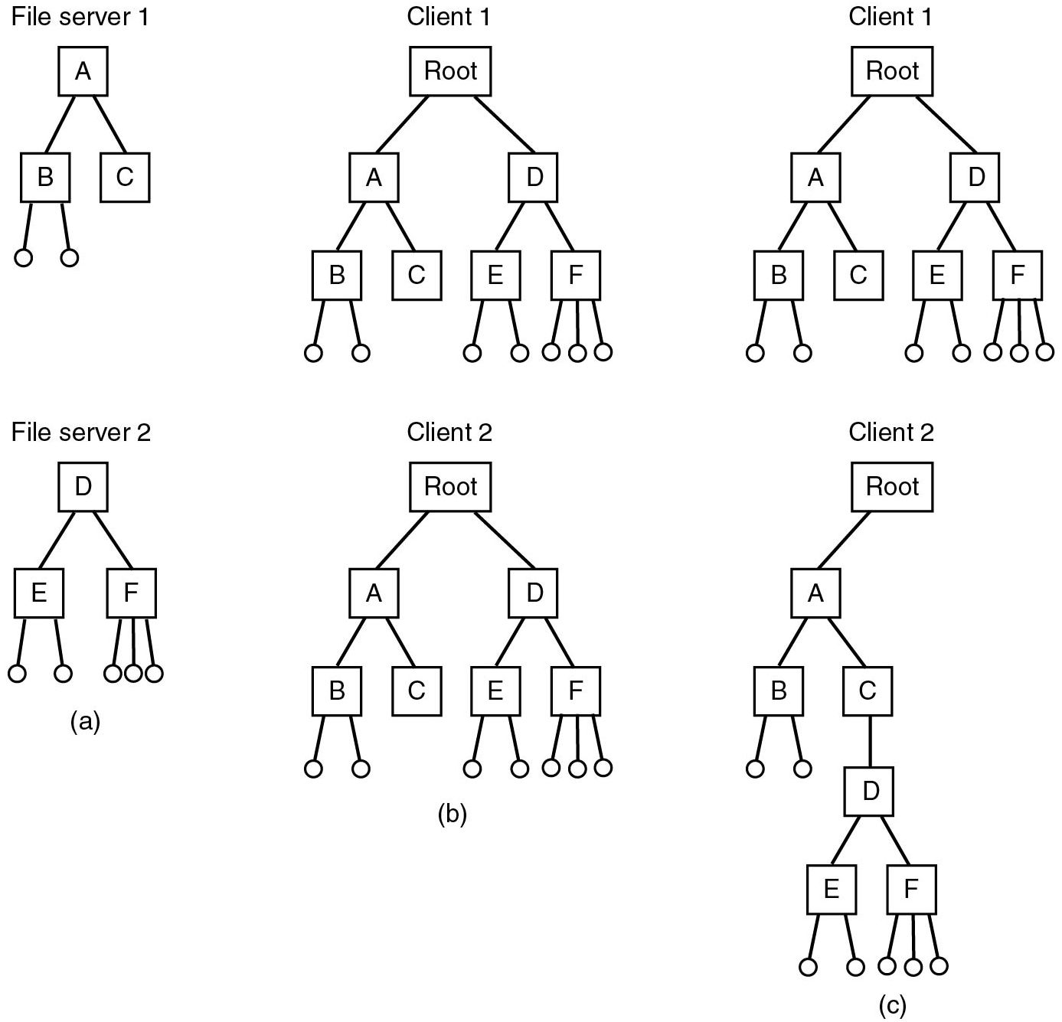
The Directory Hierarchy
Another issue: Do all clients have same view of file hierarchy?
Related:
Is there a global root directory?
Figure 8.34 (a) Two file servers. The squares are directories and the circles are files. (b) A system in which all clients have the same view of the file system. (c) A system in which different clients may have different views of the file system.
Notes:
Long Description:
Part (a): There is a File server 1 in which the top (root) node A is connected to parent nodes B and C from left to right. There are two leaf nodes from node B. There is a File server 2 in which the top (root) node D is connected to parent nodes E and F from left to right. There are two leaf nodes from node E. There are three leaf nodes from node F. Part (b): There is a Client 1 in which the top (root) node is connected to parent nodes A and D from left to right. There are two child nodes from node A labeled B and C from left to right. There are two leaf nodes from node B. There are two child nodes from node D labeled E and F from left to right. There are two leaf nodes from node B. There are two leaf nodes from node E. There are three leaf nodes from node F. There is a Client 2 in which the top (root) node is connected to parent nodes A and D from left to right. There are two child nodes from node A labeled B and C from left to right. There are two child nodes from node D labeled E and F from left to right. There are two leaf nodes from node B. There are two leaf nodes from node E. There are three leaf nodes from node F. Part (c): There is a Client 1 in which the top (root) node is connected to parent nodes A and D from left to right. There are two child nodes from node A labeled B and C from left to right. There are two leaf nodes from node B. There are two child nodes from node D labeled E and F from left to right. There are two leaf nodes from node E. There are three leaf nodes from node F. There is a client 2 in which the top (root) is connected to parent node A on the left. Node A has two child nodes B and C from left to right. From node C, there is a child node D. From node D, two child nodes E and F from left to right. There are two leaf nodes from node B. There are two leaf nodes from node E. There are three leaf nodes from node F.

Slide 68
Naming Transparency
Common approaches to file and directory naming in a distributed system:
Machine + path naming, such as
/machine/path or machine:path
Mounting remote file systems onto the local file hierarchy.
A single name space that looks the same on all
machines
This is much harder to implement!
A system in which files can be moved without their names changing is said to have location independence

Slide 69
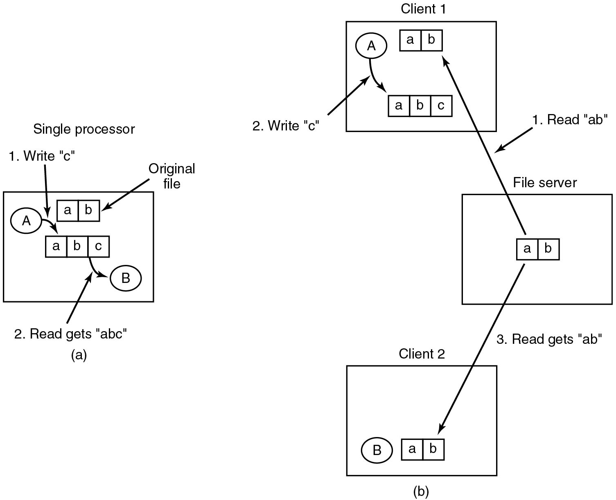
Semantics of File Sharing
Sequential consistency System enforces a total ordering on system calls, and all C P Us see same ordering.
Figure 8.35 (a) Sequential consistency. (b) In a distributed system With caching, reading a file may return an obsolete value.
Notes:
Long Description:
Part (a): There is a squared block labeled Single Processor and two circles labeled A and B from top to bottom. There is a horizontal block labeled the original file with two partitions labeled a and b. There is a horizontal block with three partitions labeled a, b, and c. From circle A, there is a downward arrow labeled 1. Write "c" points to a horizontal block with three partitions. From three partitions, there is a downward arrow is labeled 2. Read gets "a b c". Part (b): There is a squared block labeled Client 1 and a circle labeled A. There is a horizontal block labeled the original file with two partitions labeled a and b. There is a horizontal block with three partitions labeled a, b, and c. From circle A, there is a downward arrow labeled 1. Write "c" points to a horizontal block with three partitions. There is a second squared block labeled File server and there is a horizontal block labeled the original file with two partitions labeled a and b. There is an upward arrow labeled 1. Read "a b" points to the first partition a and b of Client 1. There is a third squared block labeled Client 2 and there is a horizontal block labeled the original file with two partitions labeled a and b and a circle labeled B. From the partition of the second block File server, a downward arrow labeled 3. Read gets "ab" points to the partition of third block Client 2.

Slide 70
Object-based Middleware
Instead of saying everything is a document or a file, everything is an object
Object
A collection of variables bundled together with
A set of methods
Best known example: C O R B A (Common Object Request Broker Architecture)
CORBA is (pretty much) dead now

Slide 71
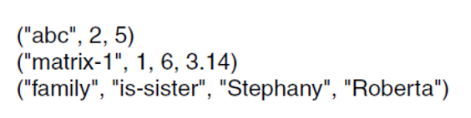
Coordination-Based Middleware: Linda (1)
Processes communicate via tuple space (global to whole system)
Tuple is like a structure in C: fields
Figure 8.36 Three Linda tuples
Operations:
out("abc", 2, 5) : puts tuple ("abc", 2, 5) in tuple space
in("abc", 2, ?i) : searches tuple space for match
if found removes it from tuple space and assigns value to i
if not, process suspended until some process generates a matching tuple
Notes:
Long Description:
left parenthesis double prime a b c double prime comma 2 comma 5 right parenthesis left parenthesis double prime matrix hyphen 1 double prime comma 1 comma 6 comma 3.14 right parenthesis left parenthesis double prime family double prime comma double prime is hyphen sister double prime comma double prime Stephany double prime comma double prime Roberta double prime right parenthesis.

Slide 72
Coordination-Based Middleware: Linda (2)
A match occurs if the following three conditions are all met:
Template and tuple have the same number of fields.
Types of corresponding fields are equal.
Each constant or variable in the template matches its tuple field.

Slide 73
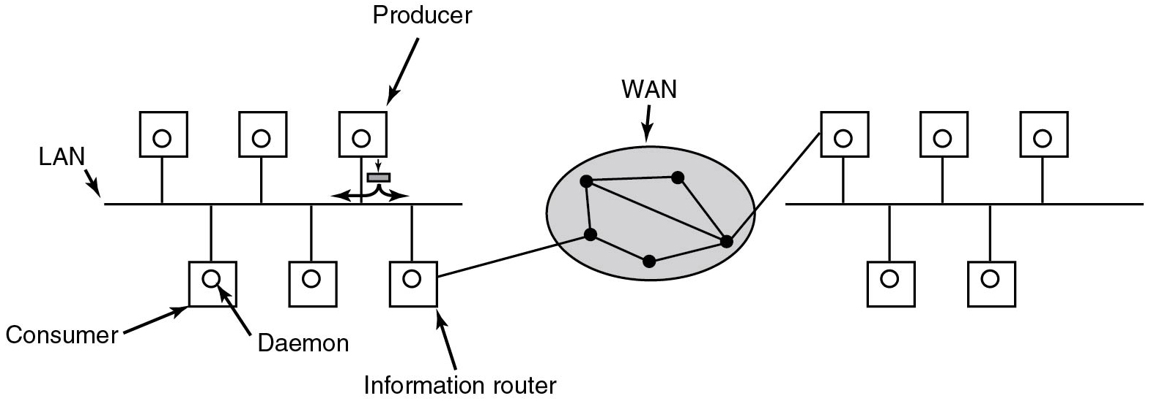
Publish/Subscribe
Figure 8.37 The publish/subscribe architecture.
Notes:
Long Description:
There are three producers in a square-shaped circle inside them connected to a common L A N. At the bottom of L A N, three square-shaped blocks circles are inside them. The first square is labeled Consumer. The circle is labeled Daemon. The third square-shaped block is labeled Information Router and this is connected to W A N. In W A N, there are multiple routers connected. On the right side of W A N, there are three square-shaped blocks with circles inside them at the top. These are connected to a common L A N. At the bottom, there are two square-shaped blocks with circles inside them.

Slide 74

Copyright
This work is protected by United States copyright laws and is provided solely for the use of instructors in teaching their courses and assessing student learning. Dissemination or sale of any part of this work (including on the World Wide Web) will destroy the integrity of the work and is not permitted. The work and materials from it should never be made available to students except by instructors using the accompanying text in their classes. All recipients of this work are expected to abide by these restrictions and to honor the intended pedagogical purposes and the needs of other instructors who rely on these materials.

